Slide 1
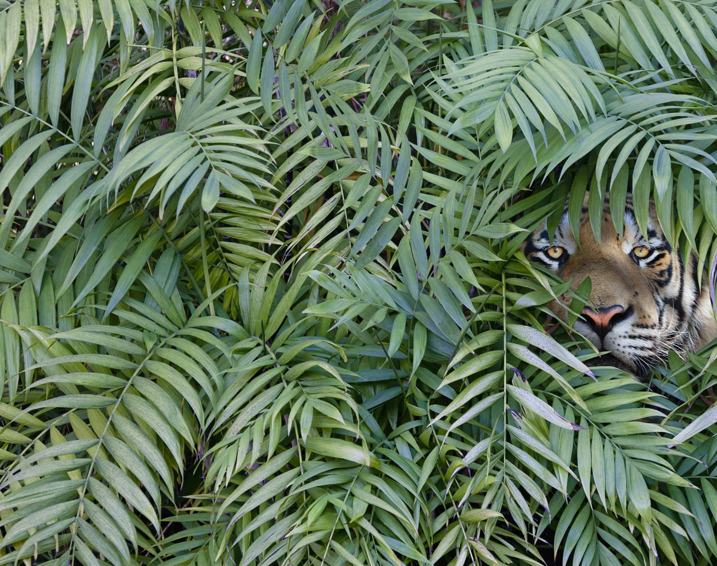
Wildlife Small Bird Detection
Stuti Trivedi
Advisor: Dr. John Korah

Slide 2
INDEX
Introduction
Motivation
Technical Background
Dataset
Hypothesis
Problem Statement
Objective
Research question
Related work
MRF
YOLO
Proposed Method
Result Analysis
Conclusion
Future Work

Slide 3
INTRODUCTION

Slide 4
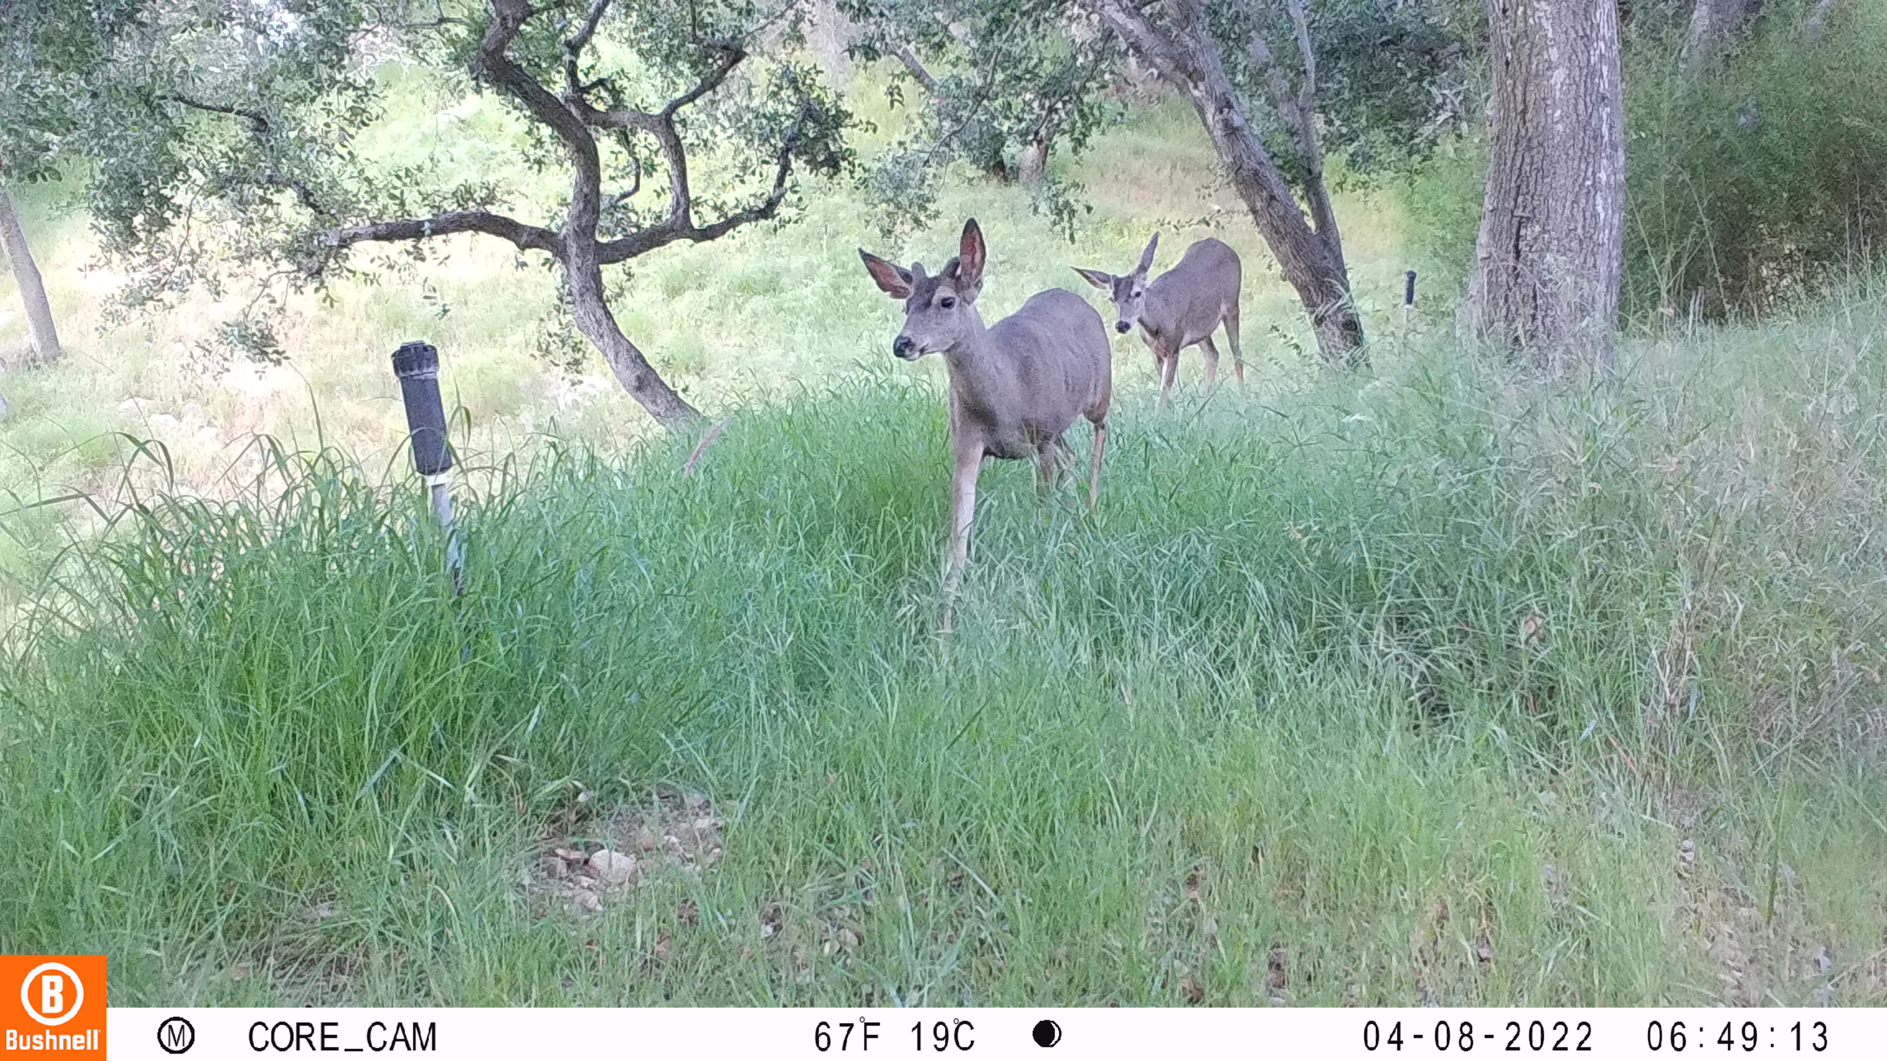
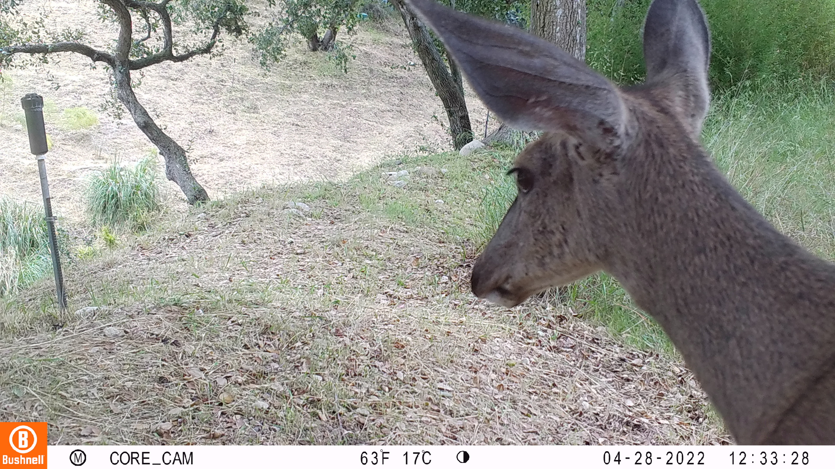
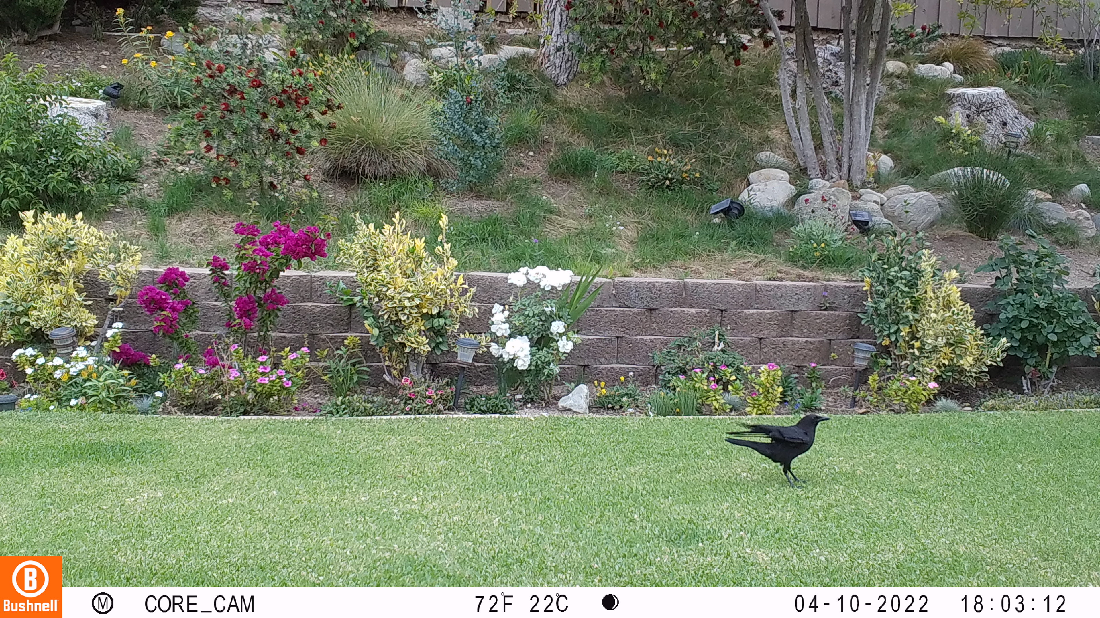
Camera-trap images
Camera trapping—“capturing” a photograph remotely
Camera traps are heat- or motion-activated cameras placed in various wildlife areas

Slide 5
Combination Camera trap and ML
Machine Learning Integration: The combination of camera traps and machine learning in wildlife detection
Object detection is technique to identify and detect objects within an image
Wildlife Identification: Machine learning models and pre-trained detectors are used for specific wildlife identification
Notes:
What is object detection, andwhat is camera trap

Slide 6
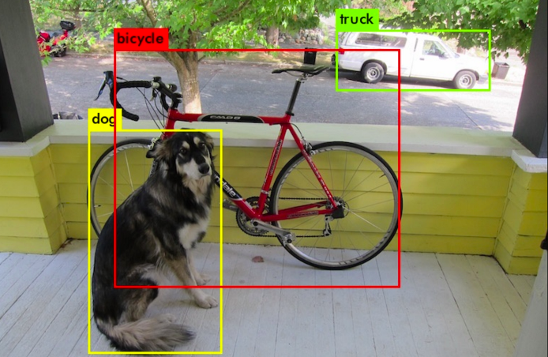
What is object detection
Object detection is the task of detecting instances of objects of a specific class within an images or videos.
It locates the existence of objects in an image using a bounding box and assigns the types or classes of the objects found.

Slide 7
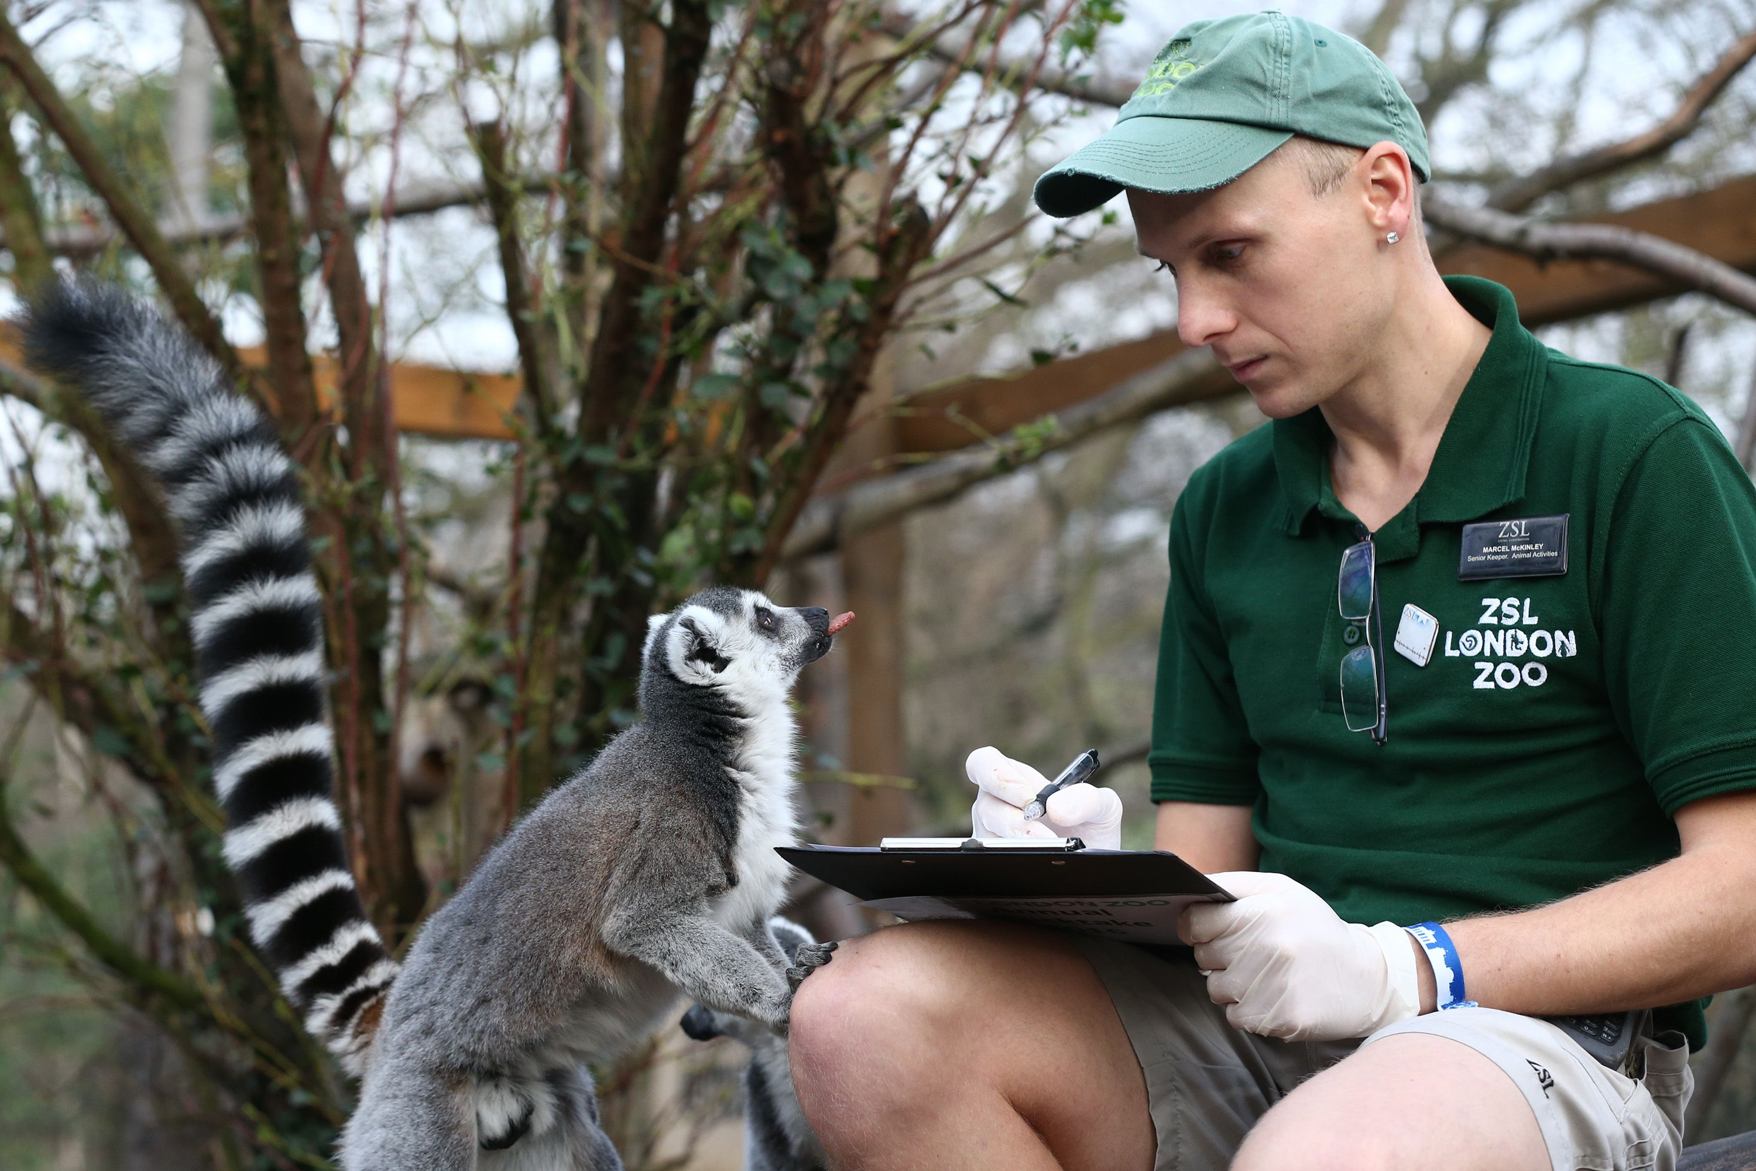
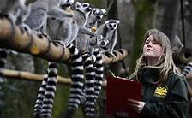
Motivation
Wildlife Monitoring and Research

Slide 8
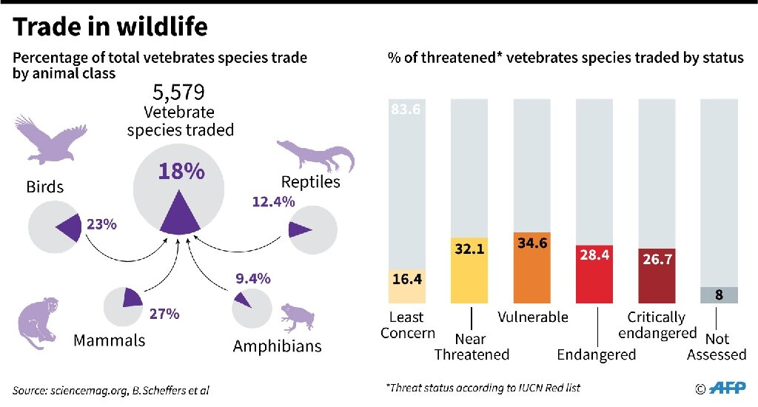
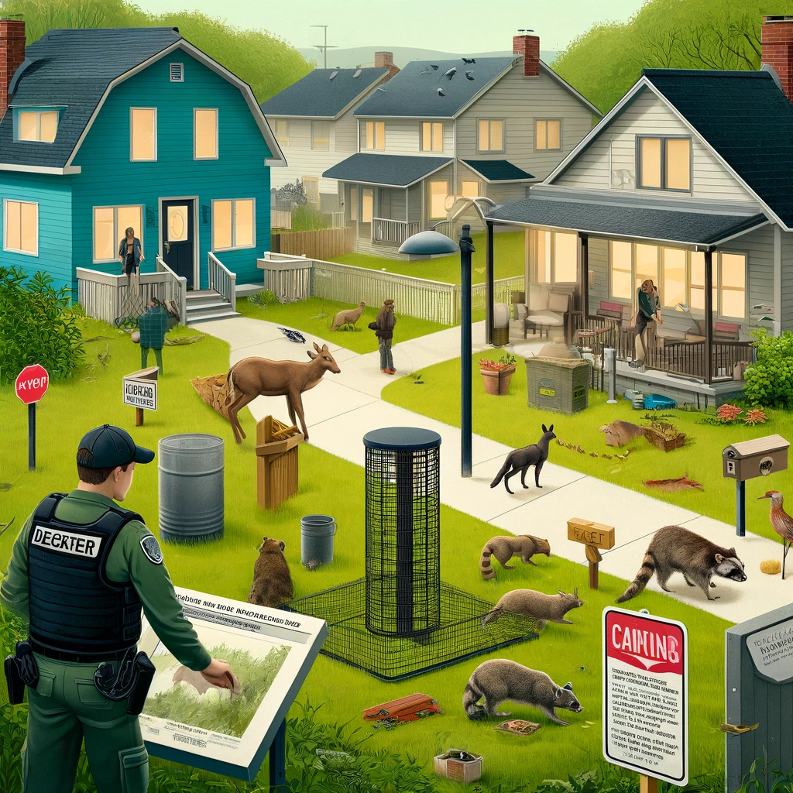
Motivation
Illegal trade
Conflict Mitigation

Slide 9
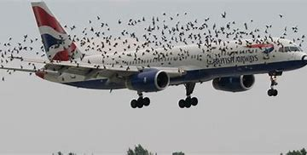
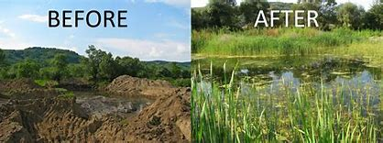
Motivation
Bird Strike Prevention
Habitat Restoration

Slide 10
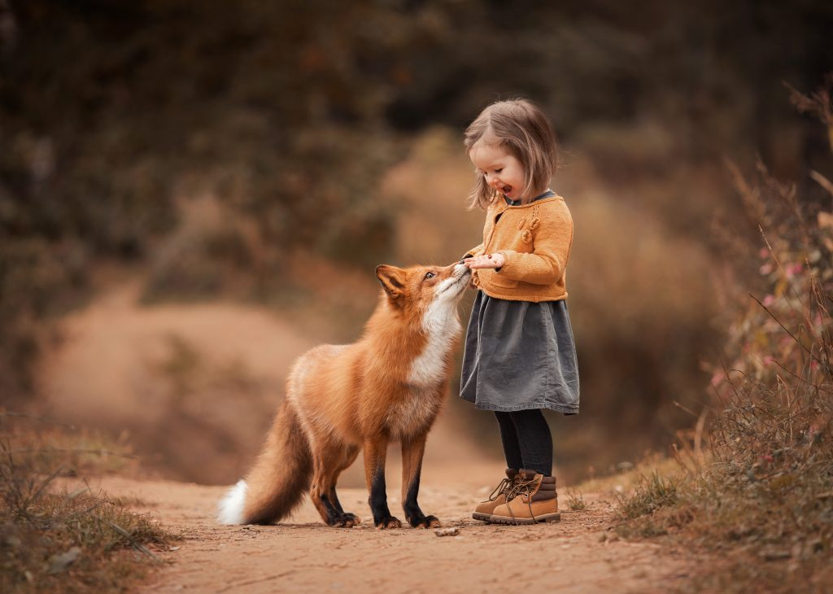
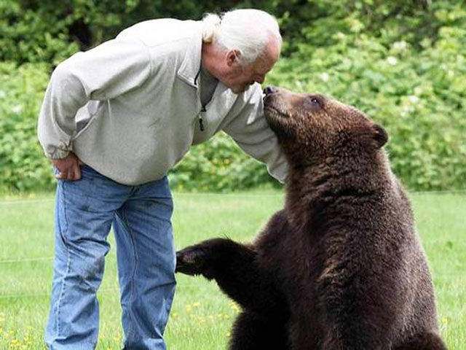
Motivation
promoting harmonious coexistence between wildlife and humans

Slide 11
TECHNICAL BACKGROUD

Slide 12
Object Detection
Object detection is a combination of two tasks:
Image classification
Object localization
Image classification algorithms predict the type or class of an object in an image among a predefined set of classes that the algorithm was trained for.
Object localization is the machine learning problem that finds whether an object exists in an image and the location of the object

Slide 13
Two Approaches for object detection
Neural Network based
Non-Neural network based

Slide 14
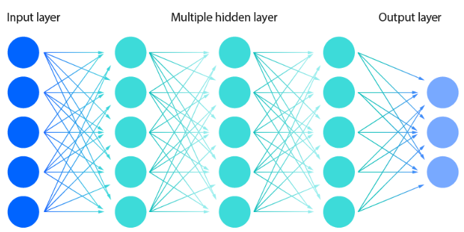
What is Neural Network
Artificial neural networks (ANNs) are comprised of a node layers, containing an input layer, one or more hidden layers, and an output layer.
If the output of any individual node is above the specified threshold value, that node is activated, sending data to the next layer of the network.
Neural network

Slide 15
Non-neural approaches
feature engineering and ML methods as a support vector machine (SVM) to do the classification
Histogram of Oriented Gradients (HOG)
Selective Search
Edge Boxes
Deformable Part Models (DPM)
Other methods based on template, shape, or color matching

Slide 16
Neural network-based approach
do end-to-end object detection without explicitly defining features.
more accurate than non-neural based and are typically built on convolutional neural networks (CNN)
Region-Based Convolutional Neural Networks (R-CNN, Fast R-CNN, etc.)
You Only Look Once (YOLO) and its versions
Single Shot Detectors(SSD), RetinaNet, EffcientNet
Neural Architecture Search (NAS)

Slide 17
Hybrid Approach
1) Feature Enhancement Prior to Deep Learning
Edge Detection + CNNs
Super-Resolution + CNNs
2) Classical Machine Learning + Deep Features
SVMs + Deep Features

Slide 18
Dataset
The Biological Science Department of Cal Poly Pomona is presently involved in a wildlife animal observation project.
Images captured in forest areas, backyards, gardens, farms, human-wildlife interface areas
Camera set up over more then 27 Southern California regions
Images more then 80K, ~70% of camera trap images are empty, due to a high rate of false Positives

Slide 19
Image properties
500 images with small and distant bird occurrence
Size: 2.06 to 2.17MB whereas for blur image 2.24 to 2.27 MB
Dimensions: 3840 X 2160
Width: 3840 pixels
Height: 2160 pixels
Horizontal and vertical resolution: 72 dpi
Bit depth: 24
Resolution unit: 2
Noise: Motion Blur and Atmospheric Conditions

Slide 20
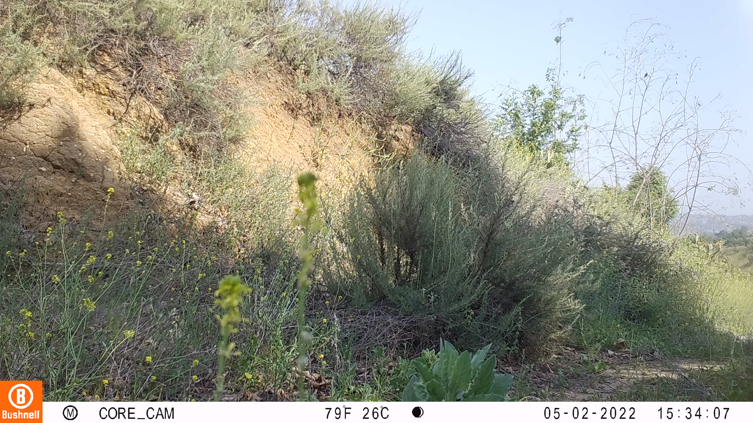

Slide 21
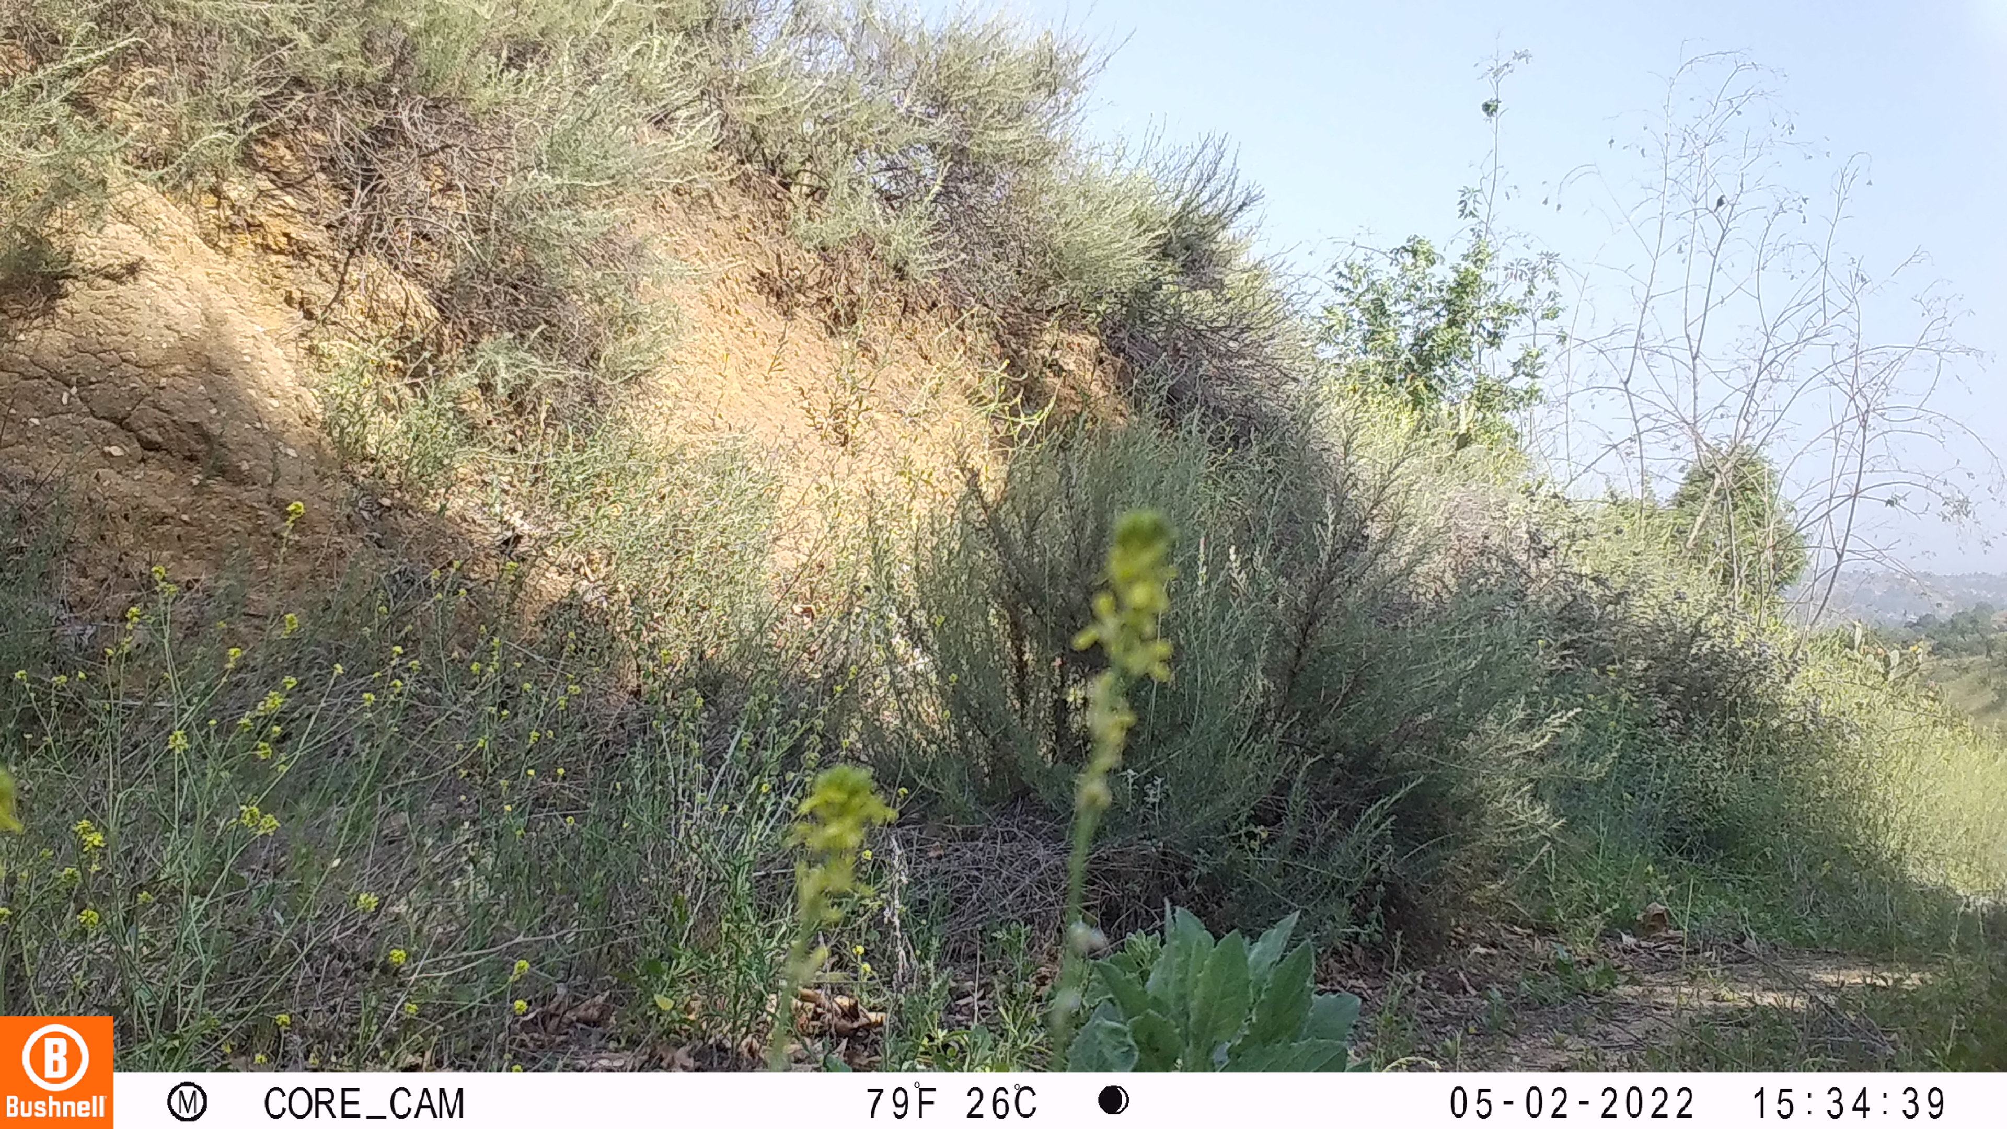

Slide 22
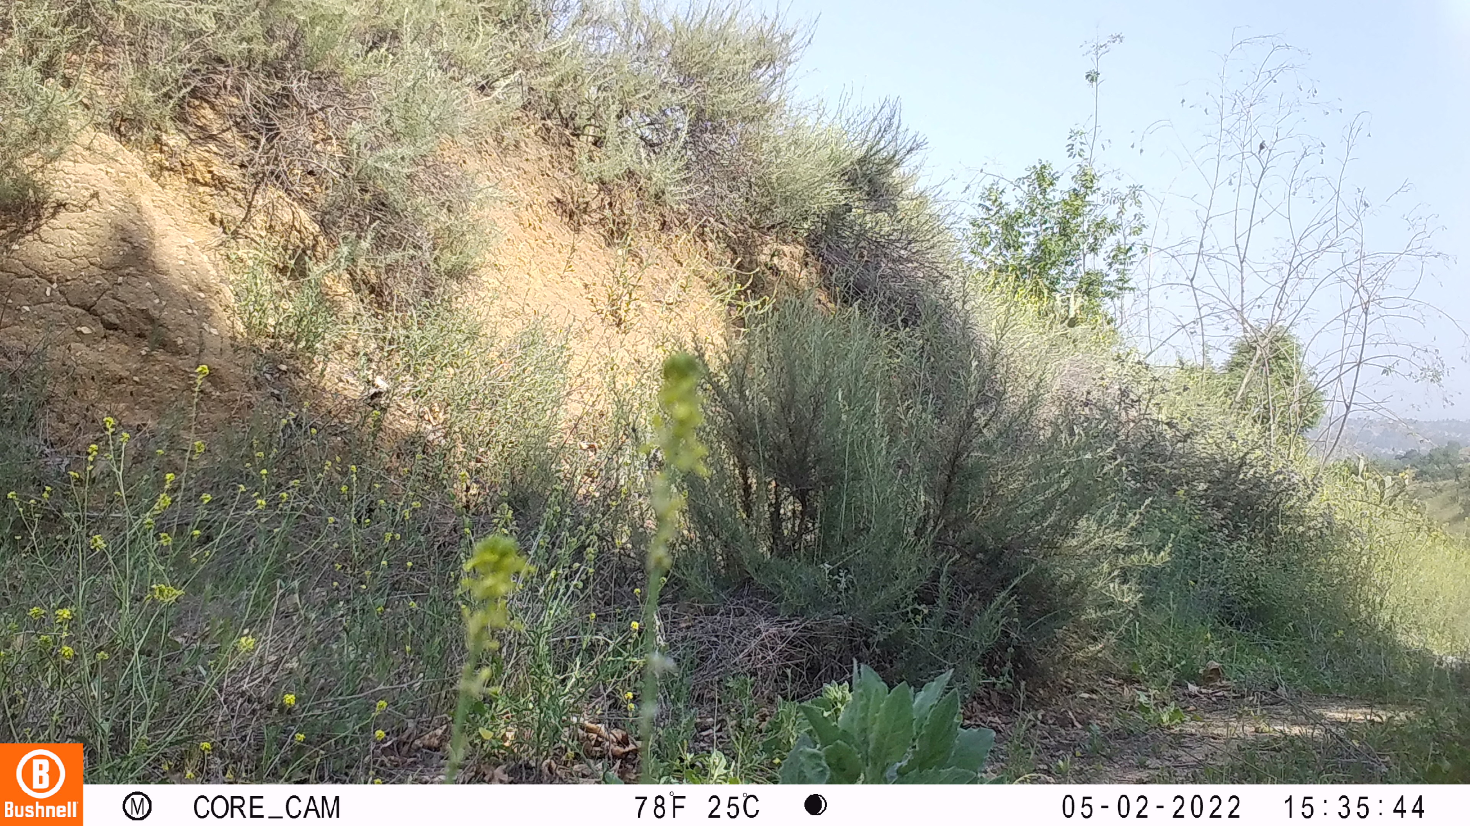

Slide 23
challenges

Slide 24
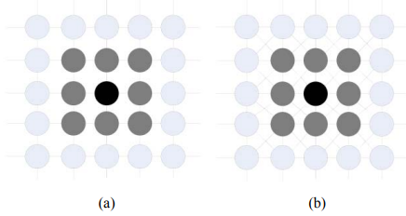
Hypothesis
Traditional object detection methods are more effective for small bird detection as we have wide range of pixel exploration.
Have that trditinal less wffectie, but multilevel detection techniques required to detect small animals
a) 4-neighbour b) 8-neighbour pixels

Slide 25
Problem Statement
Inadequate Detection of Small and Distant Objects: Challenging to detect distant birds and objects due to their size, low resolution, and blending with the background.
High-Level CNN Features: These CNN models rely on high-level CNN features leads to computationally intensive resources.
Need for Advanced Detection Techniques: Integrating Non-Neural Network based Markov Random Field (MRF) techniques with YOLO

Slide 26
Objectives
1: Non –neural network Method:check that
Evaluate Markov Random Field (MRF) technique for change detection to identify pixel-level changes over different timestamps between images.
2: Comparative Analysis
Evaluate and compare the the traditional (MRF-based) and CNN-based (modified YOLO) approaches for detecting small birds.

Slide 27
Research question
How effectively traditional object detection method identify small animal in dense and blur background images ?
Could traditional methods outperform CNN approaches in detecting small birds within images?

Slide 28
Talk about methodology in generic menner, with technical,
Key ideas, with picture
Connect all slides together
What is key idea on using

Slide 29
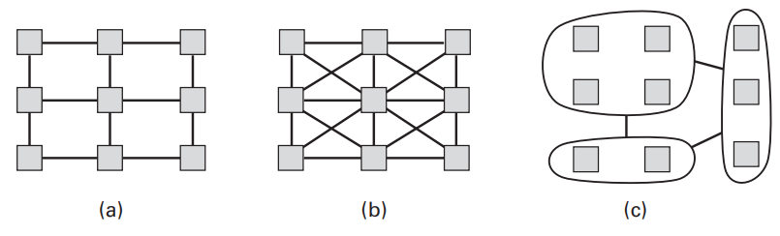
Markov model
G = (V, E, Metioned clearly on definitions, remove graph a extra, talk about
V = (1, 2, . . . , i, . . . , N ) corresponding to the pixels of the image
E = edge (i, j), where i, j ∈ V
edges are considered to be undirected,
so that (i, j ) and (j, i) refer to the same edge
(a) Simple 4-connected grid of image pixels. (b) the 8-connected pixel grid. (c) Irregular grids are also useful. Here a more compact graph is constructed in which the nodes are super pixels—clusters of adjacent pixels with similar colors.

Slide 30
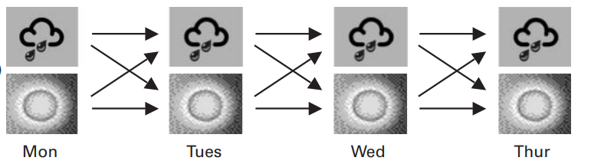
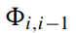
Markov Random Field
A Markov Random Field, also known as a Markov network, is a model for the joint distribution of a set of variables, 𝑋=(𝑋1,𝑋2,...,𝑋𝑛) with respect to a particular undirected graph
a)
b)
c)
a) Weather state probability with MRF, b) undirected graph c)
Is a factor of the joint density

Slide 31
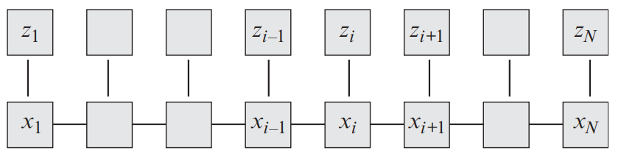
Hidden Markov Model
A Hidden Markov Model (HMM) is a statistical model that assumes the system being modeled is a Markov process with unobserved (hidden) states.
useful as prior models for state variables Xi that are to be inferred from a corresponding set of measurements or observations z = (z1, z2,..., zi,...,zN )
where trivially
Fig: Hidden MFR undirected graph

Slide 32
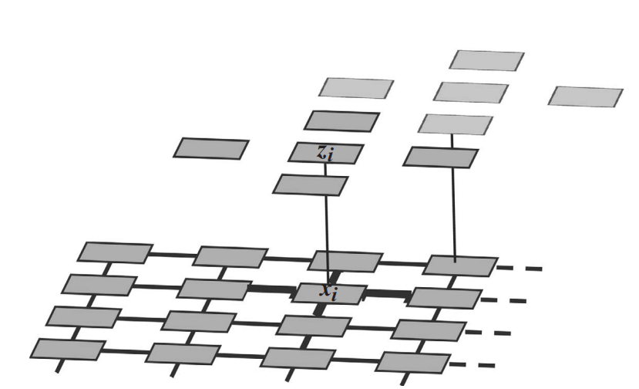
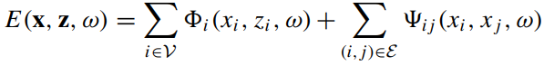
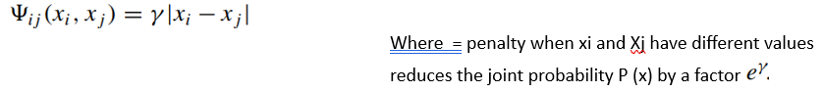
Hidden Markov Random Field
X = layer of hidden variable
Z = observations where each individual observation zi depends statistically just on the state xi of the corresponding pixel
The energy functions for many commonly used Markov models can be written as a sum of unary and pairwise terms

Slide 33
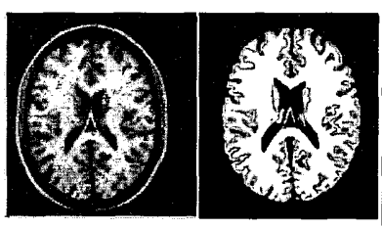
Related Work
1) MRF in MRI
To segment an image into disjoint of regions, a Markov Random Field model is applied to the segmentation labels (binary labels per region)
where the prior probability distribution of these labels is influenced by spatial adjacency, modeled by a Gibbs distribution across cliques of the neighborhood. [1]
Fig: Slice of a simulated MFU volume (left) and the Corresponding segmentation (right).

Slide 34
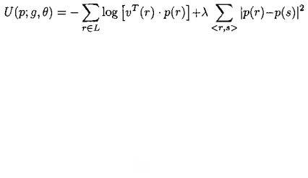
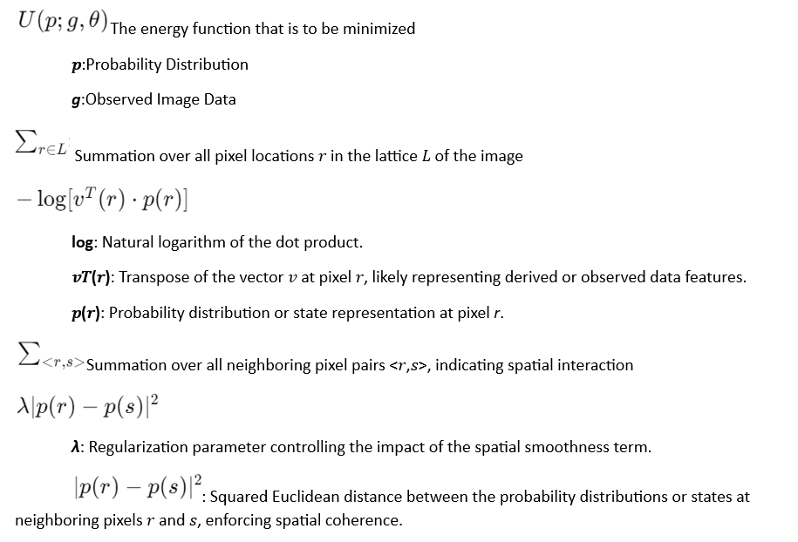
Related work
1) MRF in MRI , rewrite equation in
Where,

Slide 35
Related Work
2) Three-Layer MRF Structure: The model introduces a novel three-layer Markov Random Field. Each layer processes different aspects of the information:
The first layer deals with direct pixel difference information.
The second layer handles correlation features.
The third layer integrates these inputs to produce a final segmentation that distinguishes between background (static objects) and foreground (moving objects or changes). [2]

Slide 36
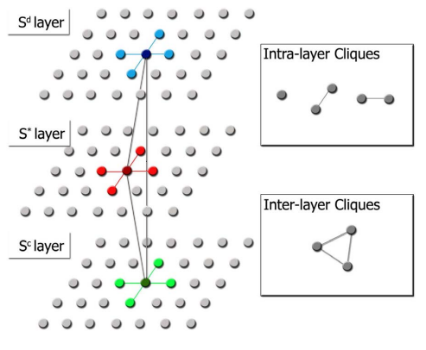
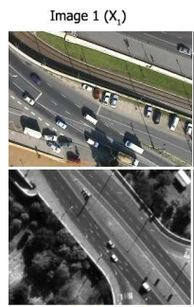
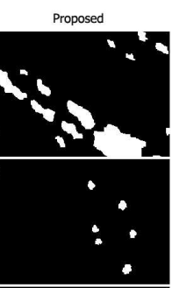
Related Work
2) Three-Layer MRF Structure Object – Motion Detection
Fig: Structure of the proposed three-layer MRF model

Slide 37
Related Work
3)The LayoutCRF for Object Detection [3]
recognizing and segmenting partially occluded objects through a structured approach that combines unary, pairwise, and instance potentials

Slide 38
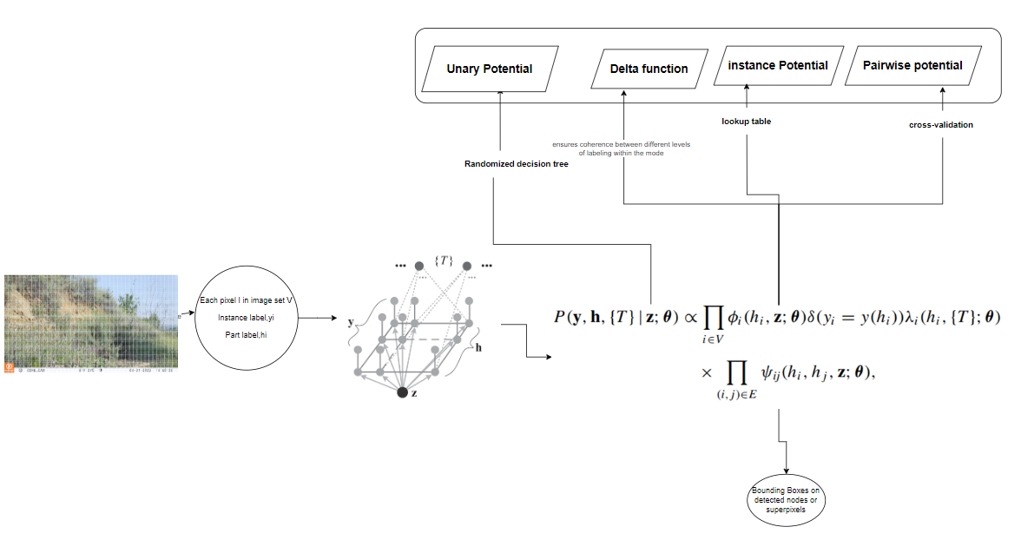
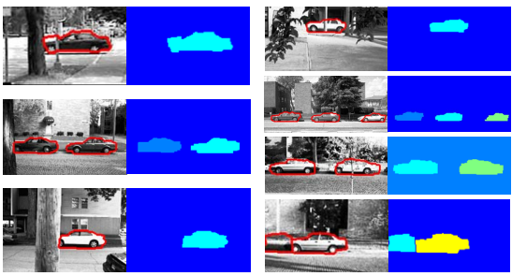
Related Work
3) The LayoutCRF for Object Detection
Fig: Example detections and segmentations
on the UIUC Database.

Slide 39
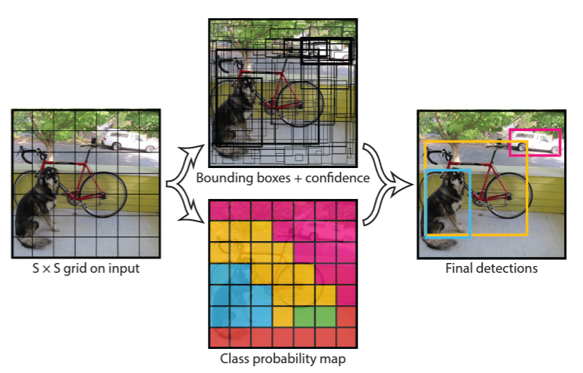
YOLO algorithm overview add architecture of YOLO

Slide 40
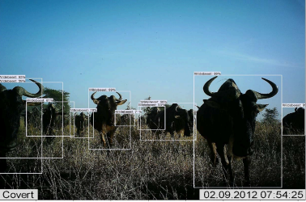
Related Work
4) Object Detection for Ecological Camera Trap Data:
Faster RCNN: Two-Step Detection: It first generates proposals for object locations and then classifies these proposals into specific categories using CNN features.
YOLOv2: Single Neural Network: YOLO uses a single convolutional network that predicts multiple bounding boxes and class probabilities for those boxes simultaneously.[4]

Slide 41
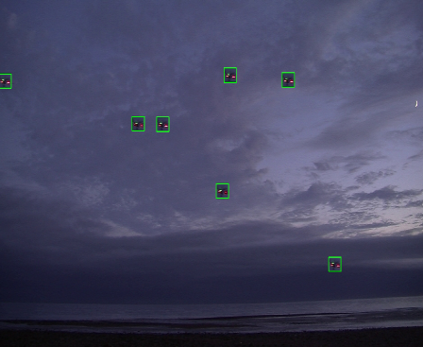
Related Work
5) High speed drone detection
Utilized the medium-size model (M-model) of YOLO-V8 optimized for high-speed an
Employed a modified copy & paste technique extensively a specialized layer added to the feature pyramid within the YOLO architecture to enhance the detection of small-sized objects. [5]
Notes:
vto increase drone representations in training imagesd efficient performance

Slide 42
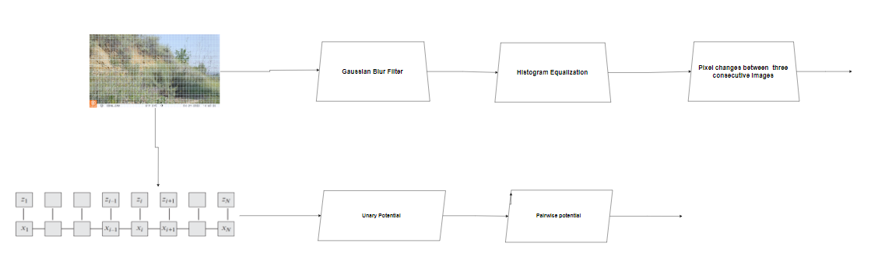
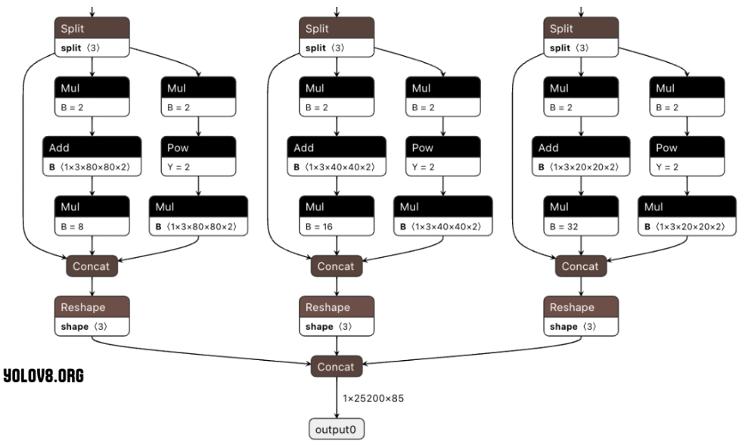
Architecture of Proposed MRF with YOLO, whenever we build asystem the picture is important, do decide your win/loss situation
Filters
As
Results
YOLOv8
as
Results

Slide 43
YOLOv8 Architecture
Split Layer: Divides input data in different network branches.
Mul (Multiply) Layer: Scales input data.
Add Layer: Performs element-wise addition, implement skip connections
Pow (Power) Layer: Applies a power function to each input element, adjusting feature activation dynamics.
Concat (Concatenate) Layer: Merges feature maps from different branches to combine diverse features.
Reshape Layer: Changes tensor dimensions to fit subsequent layers or output requirements.
Output Layer: Produces the final predictions including bounding box coordinates, confidence scores, and class probabilities.

Slide 44
RESULT ANALYSIS

Slide 45
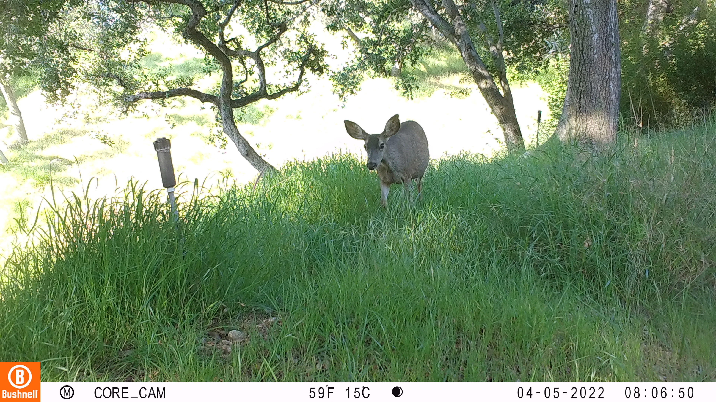
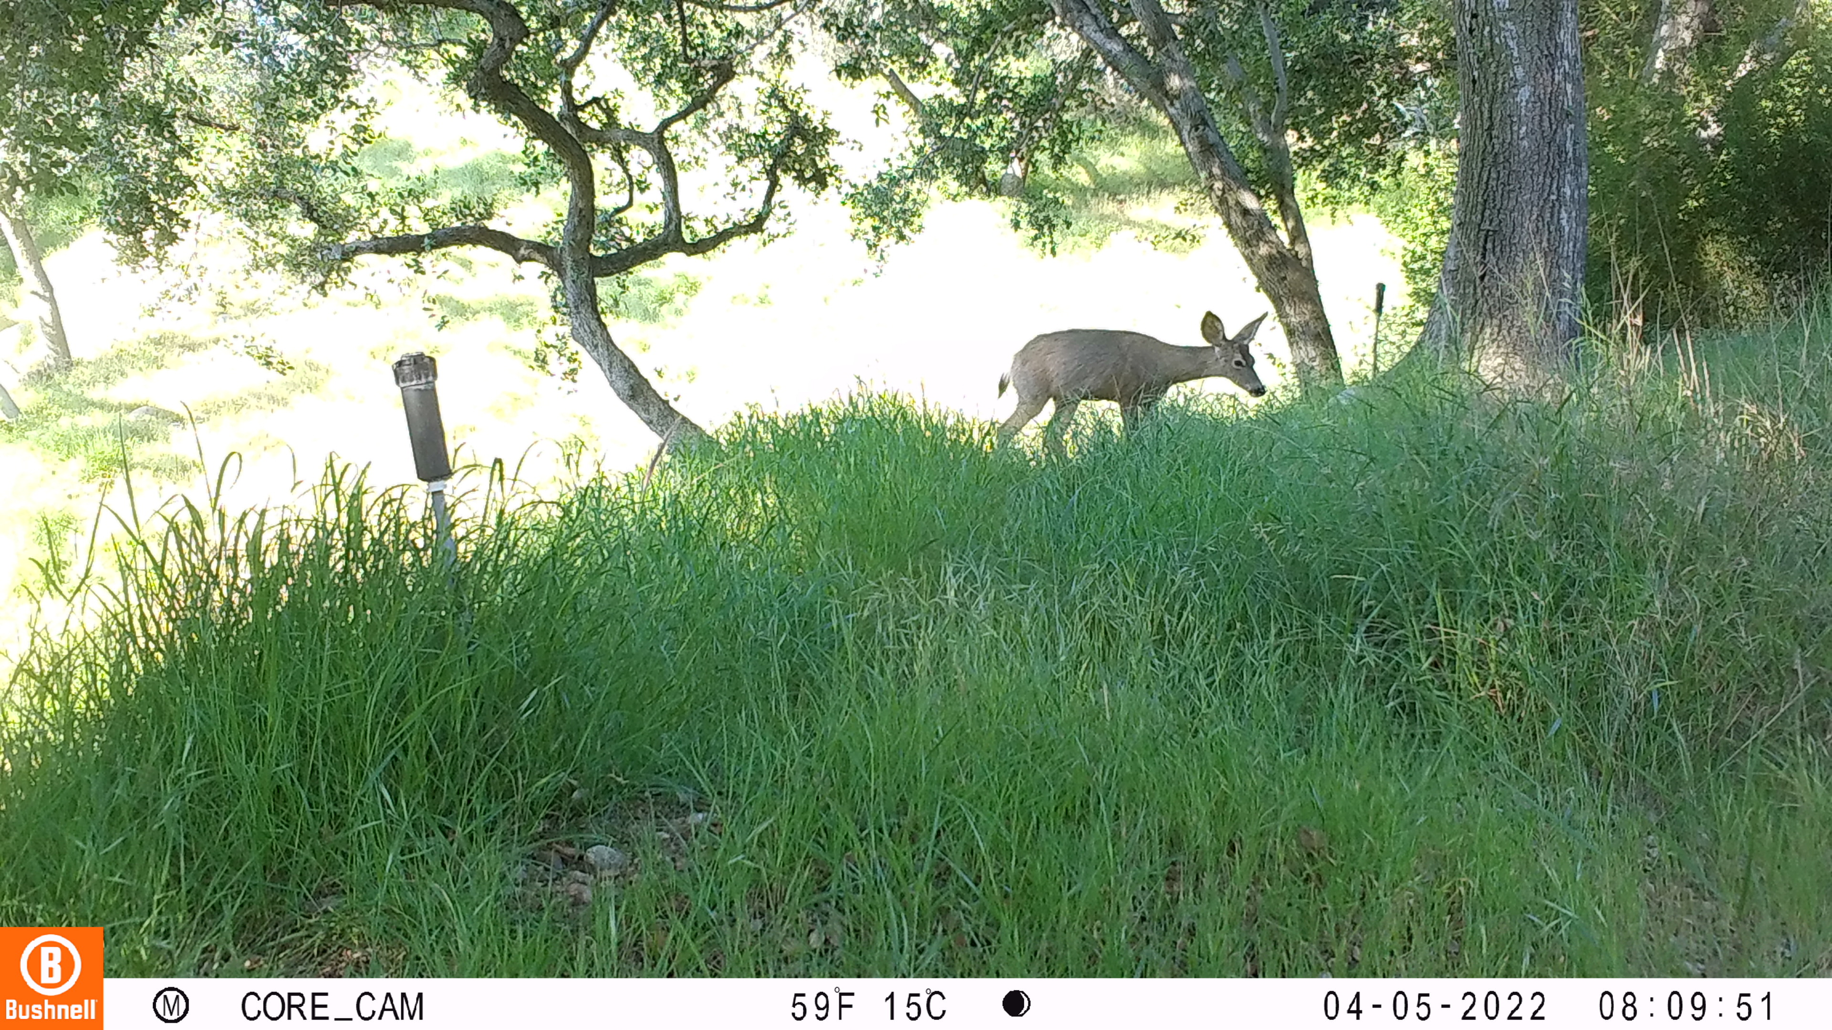
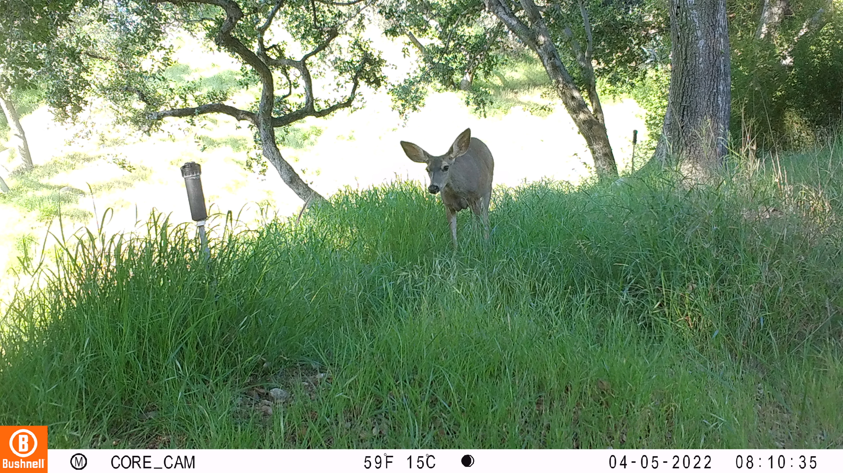
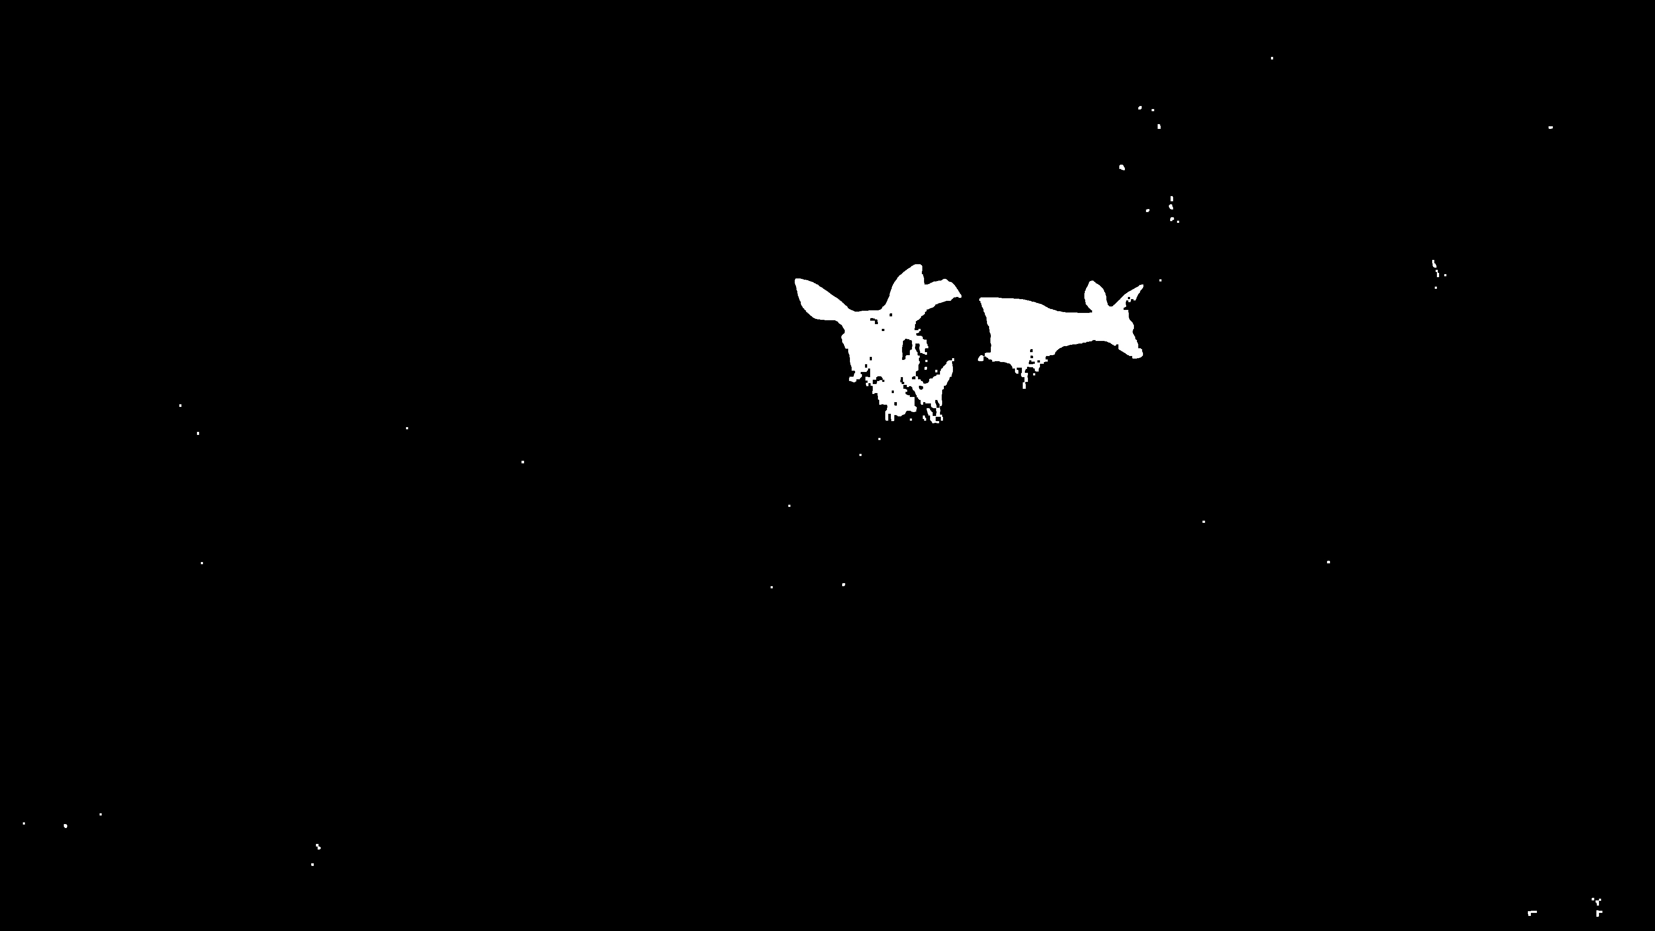
Results with Filters

Slide 46
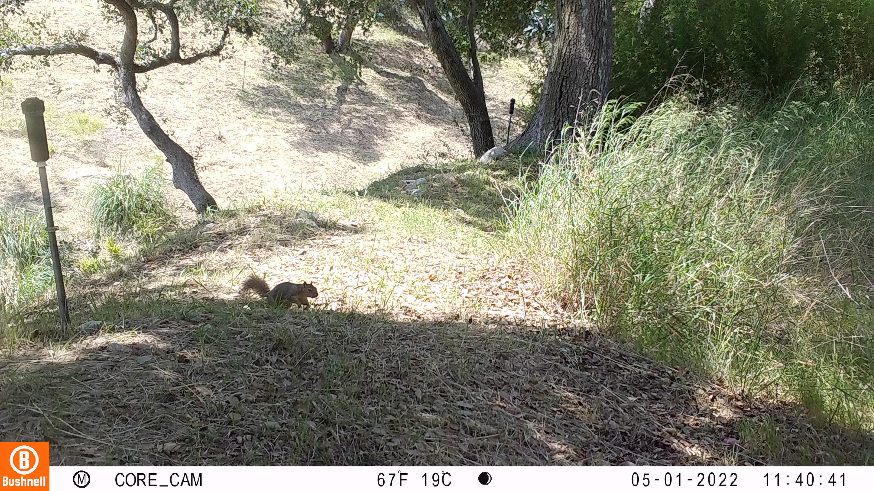
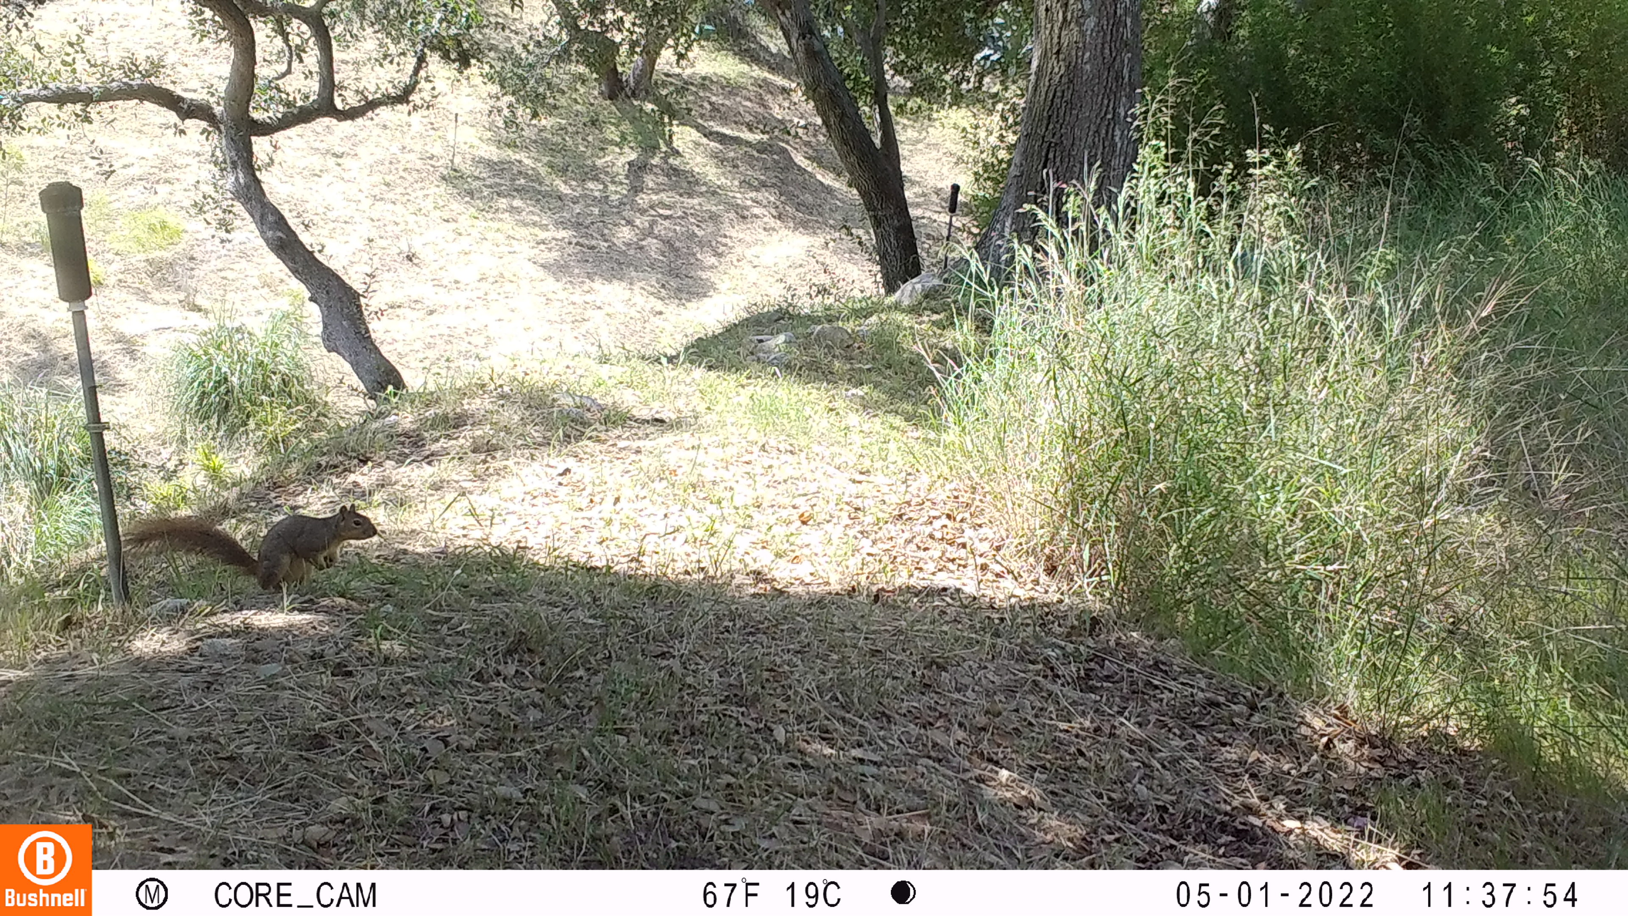
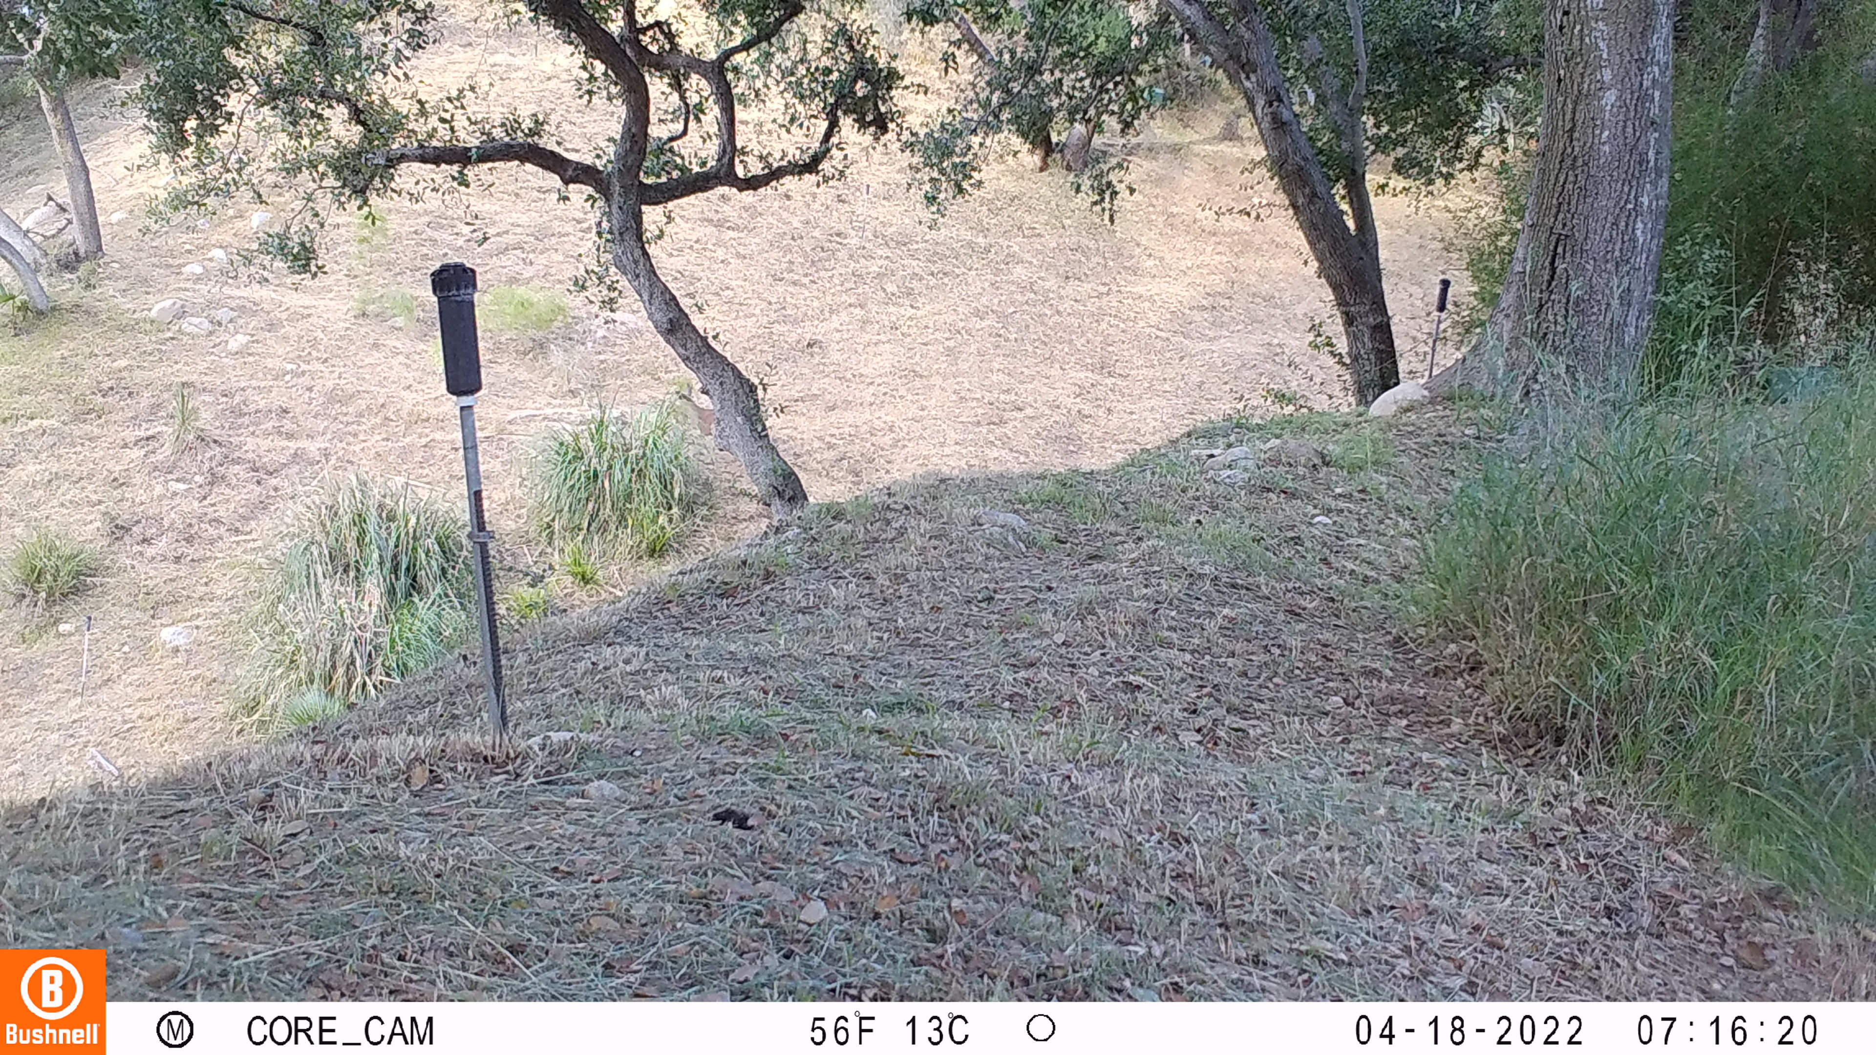
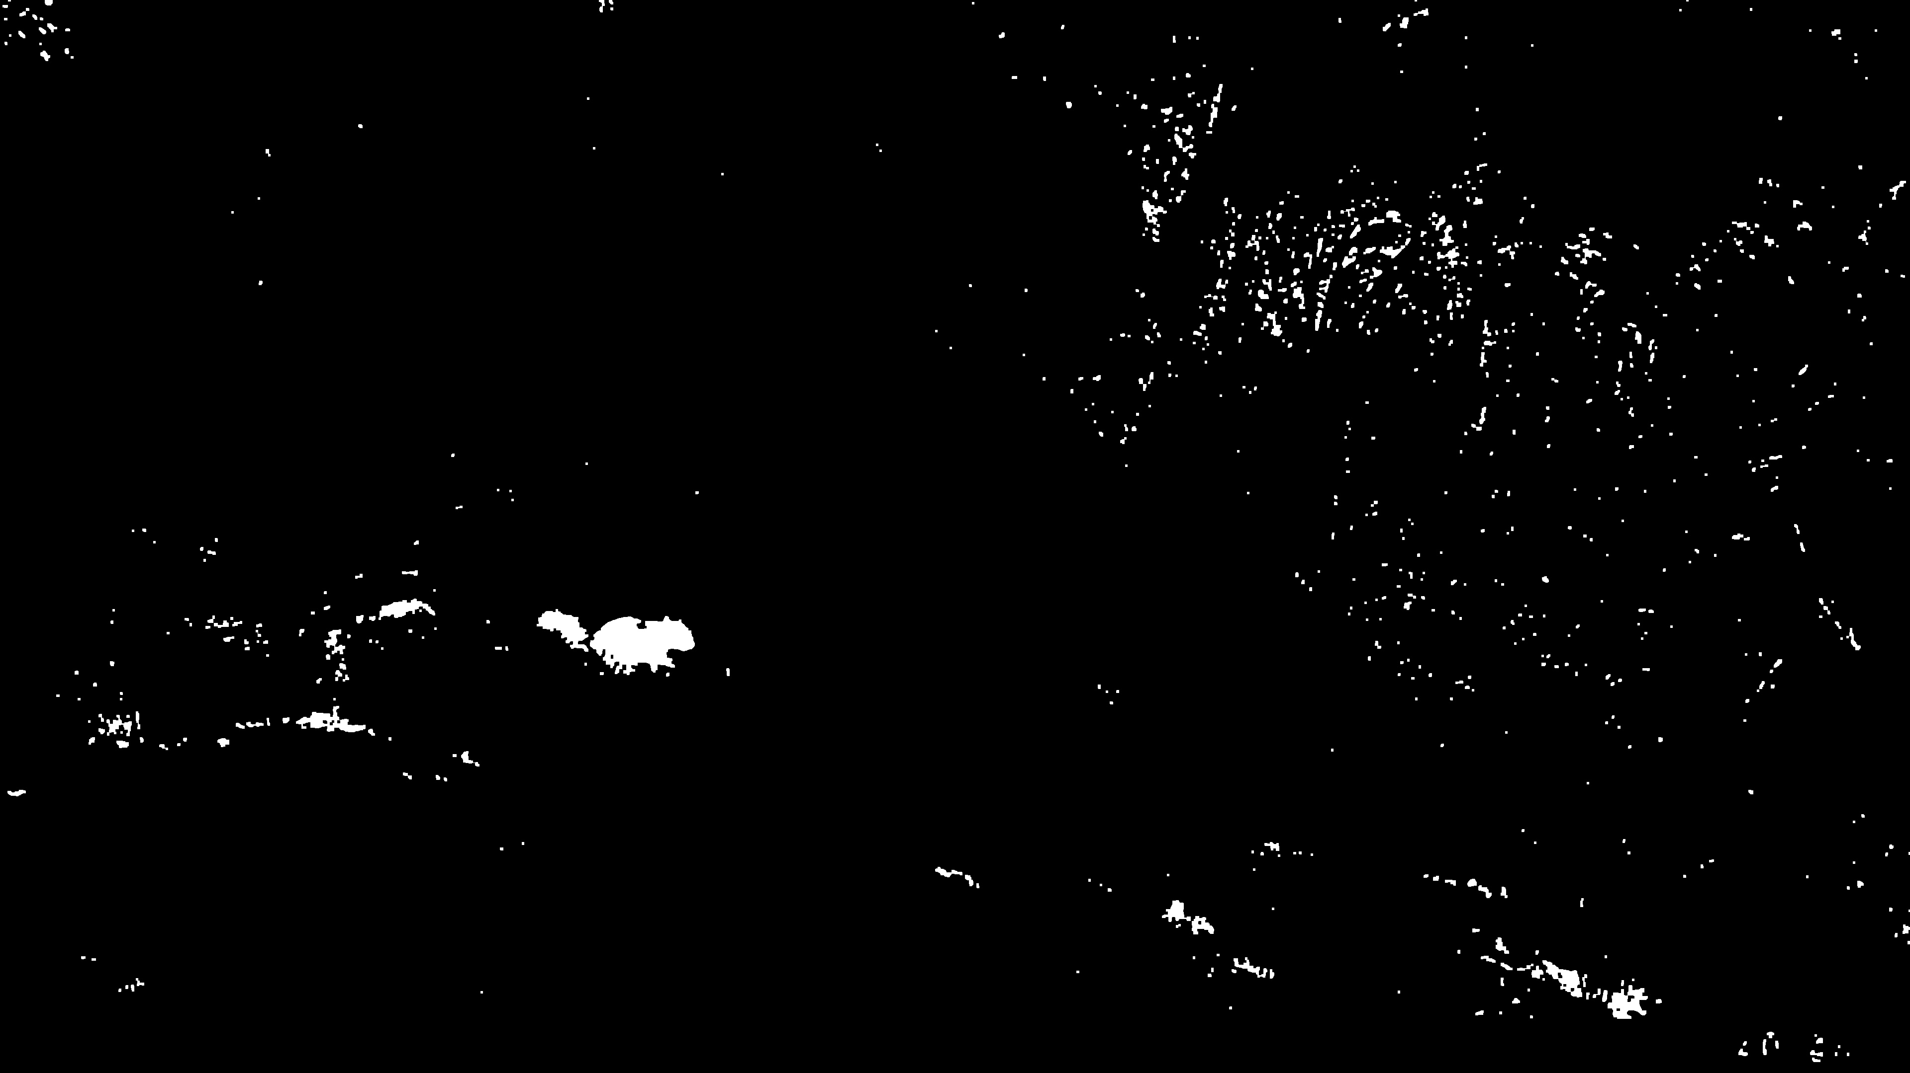
Results with Filters

Slide 47
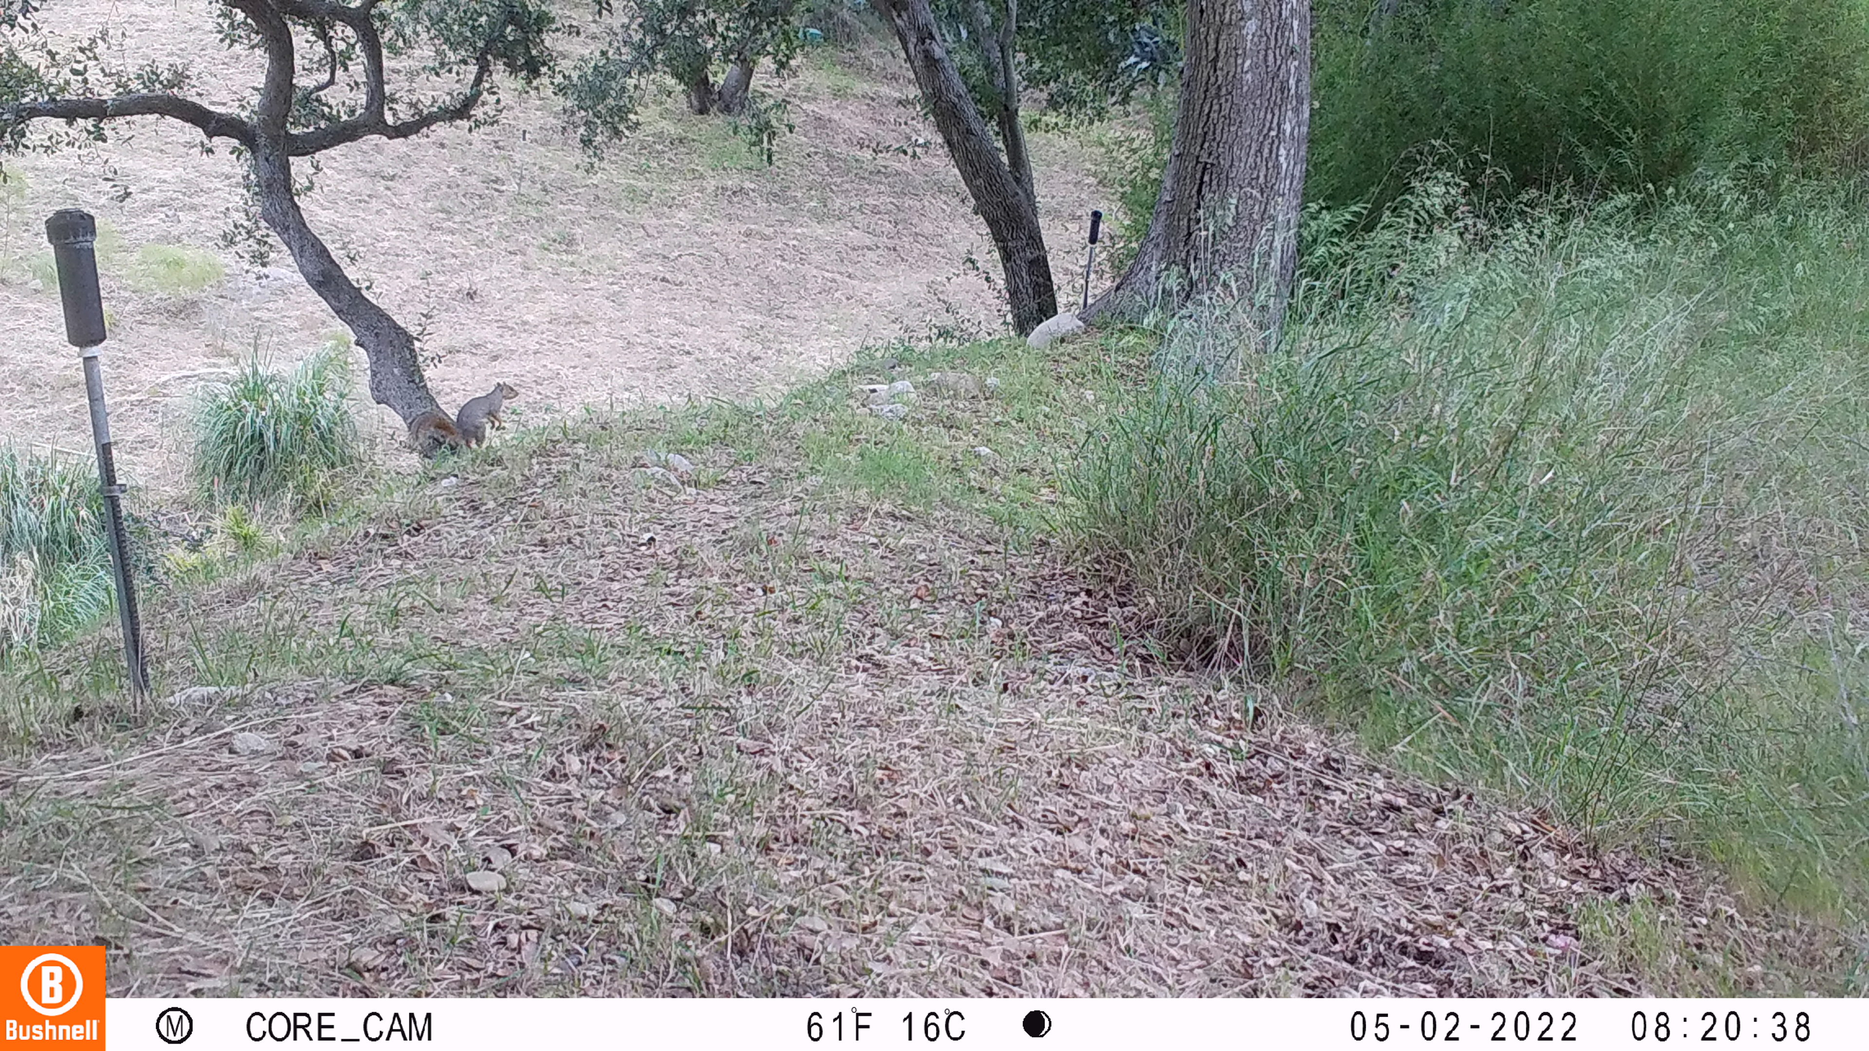
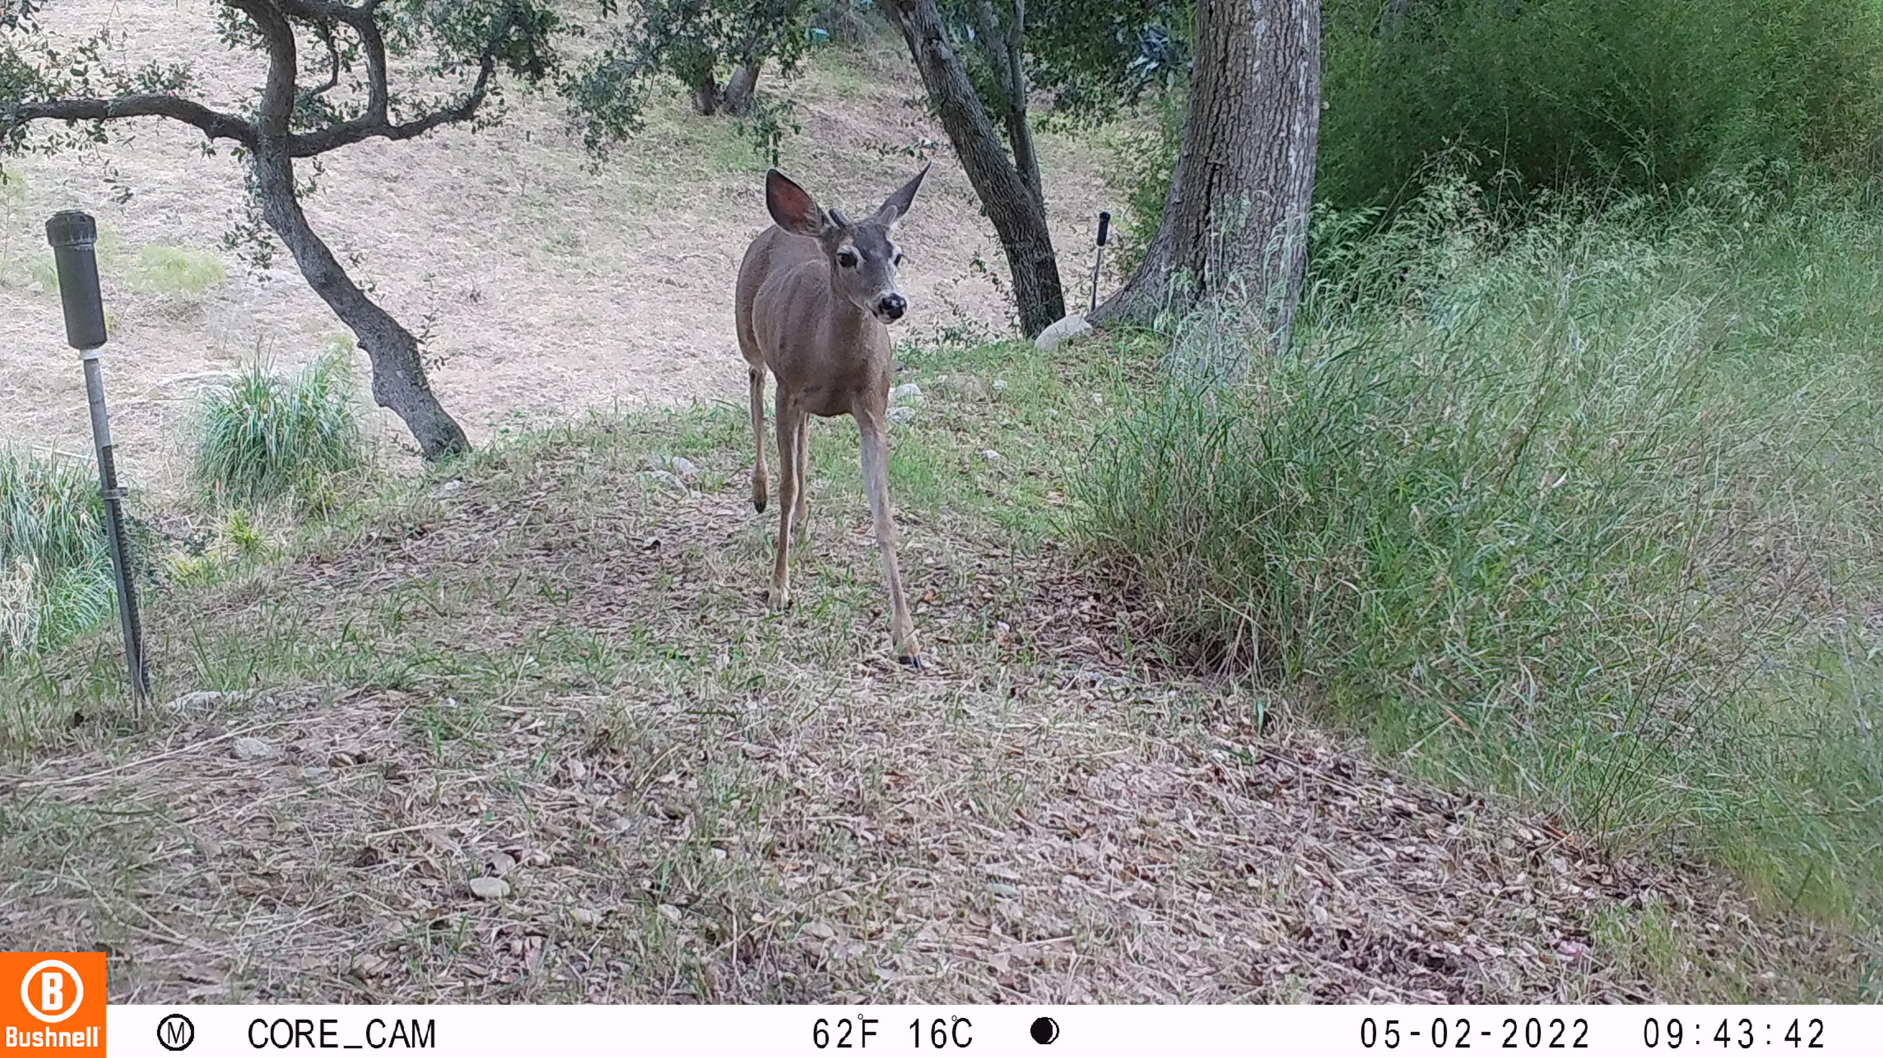
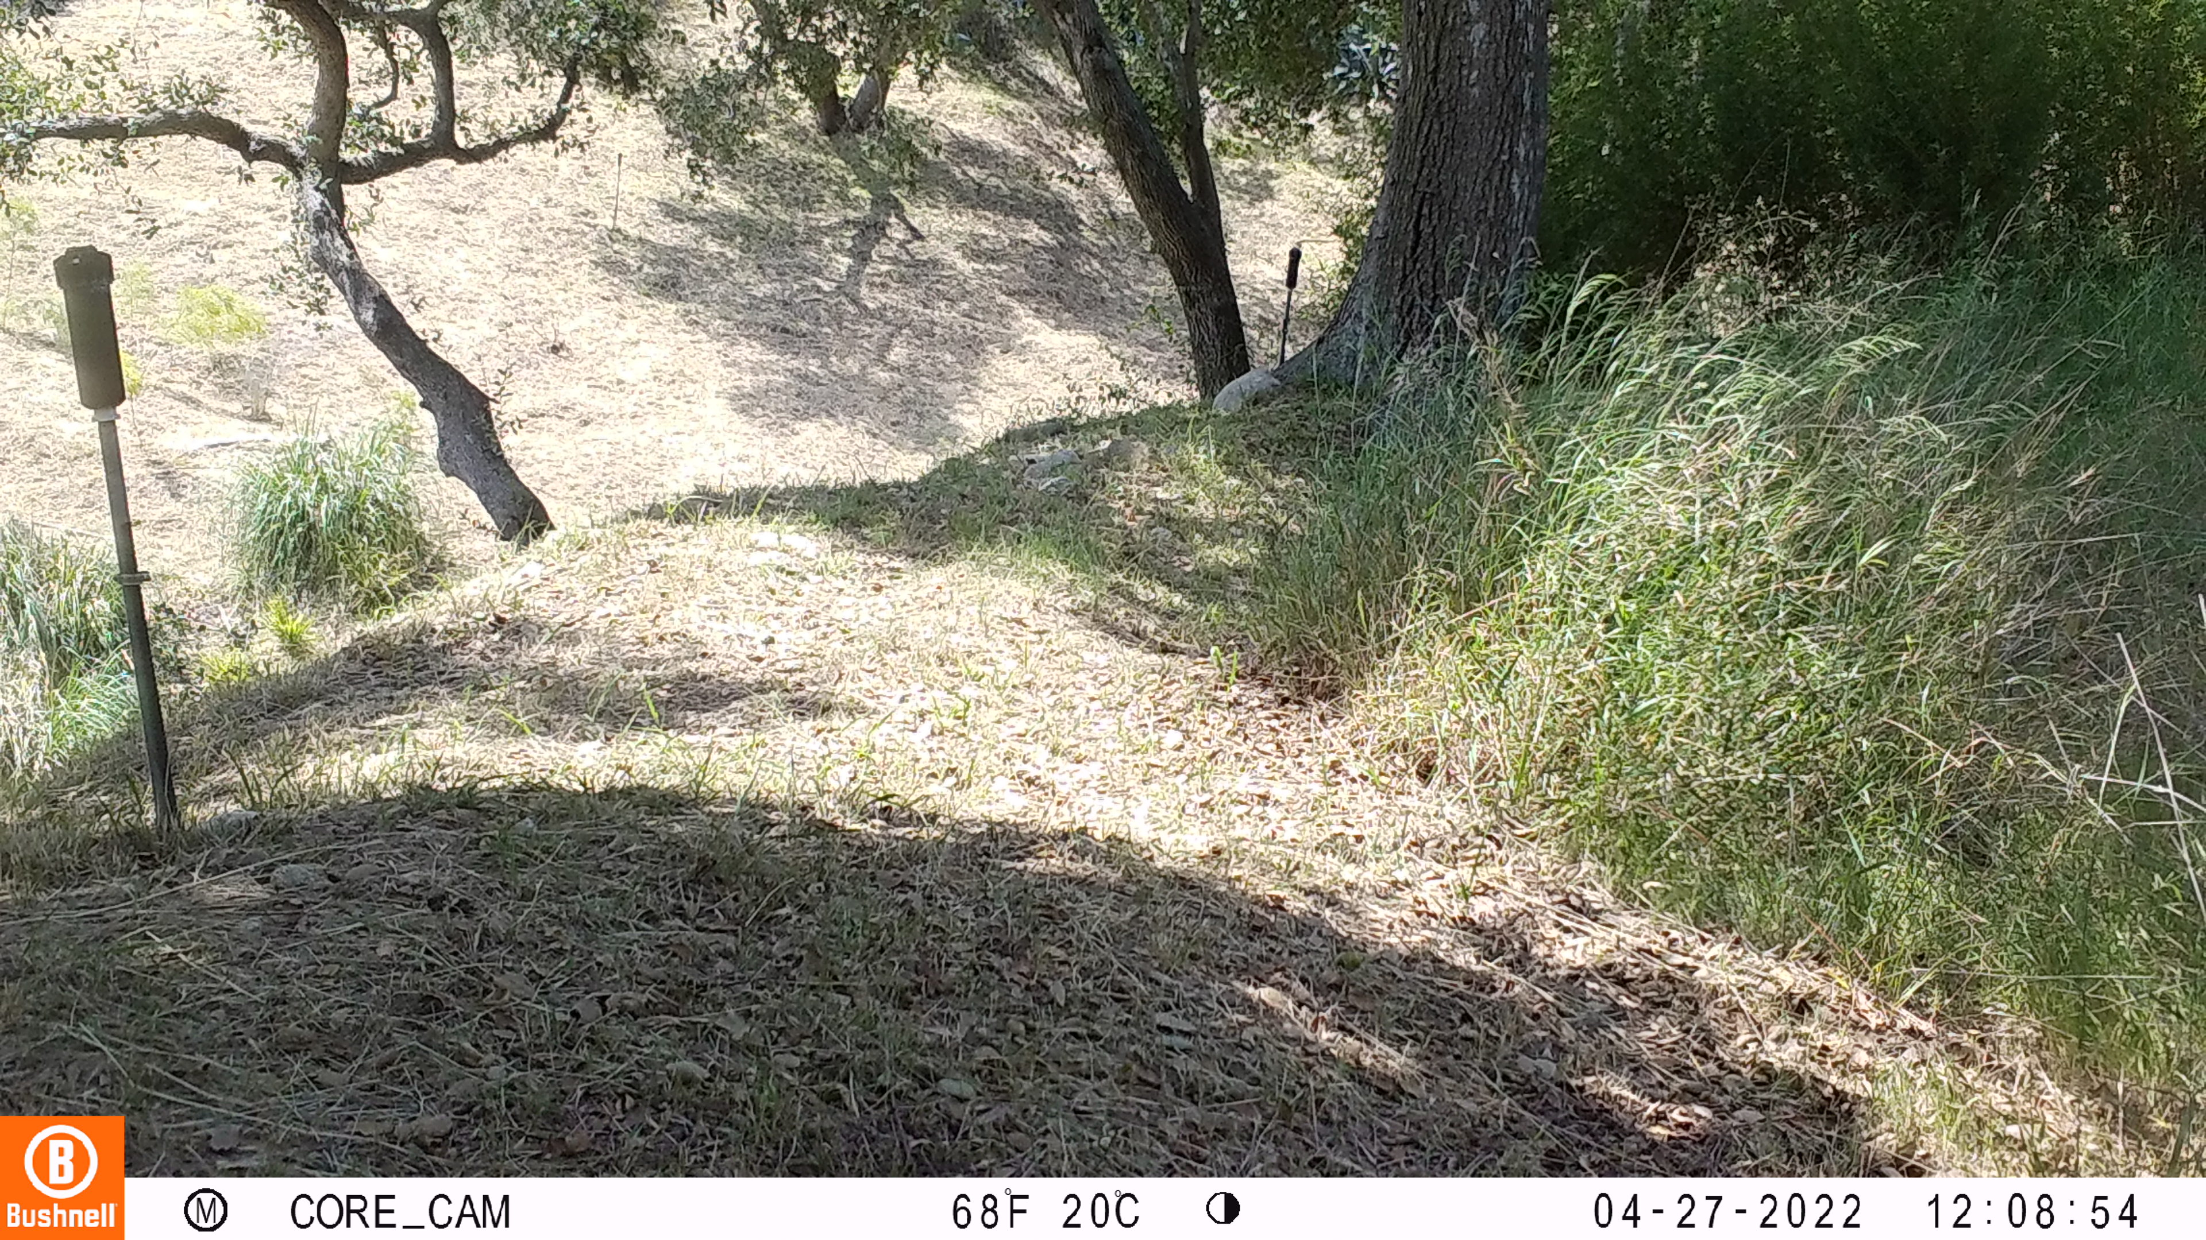
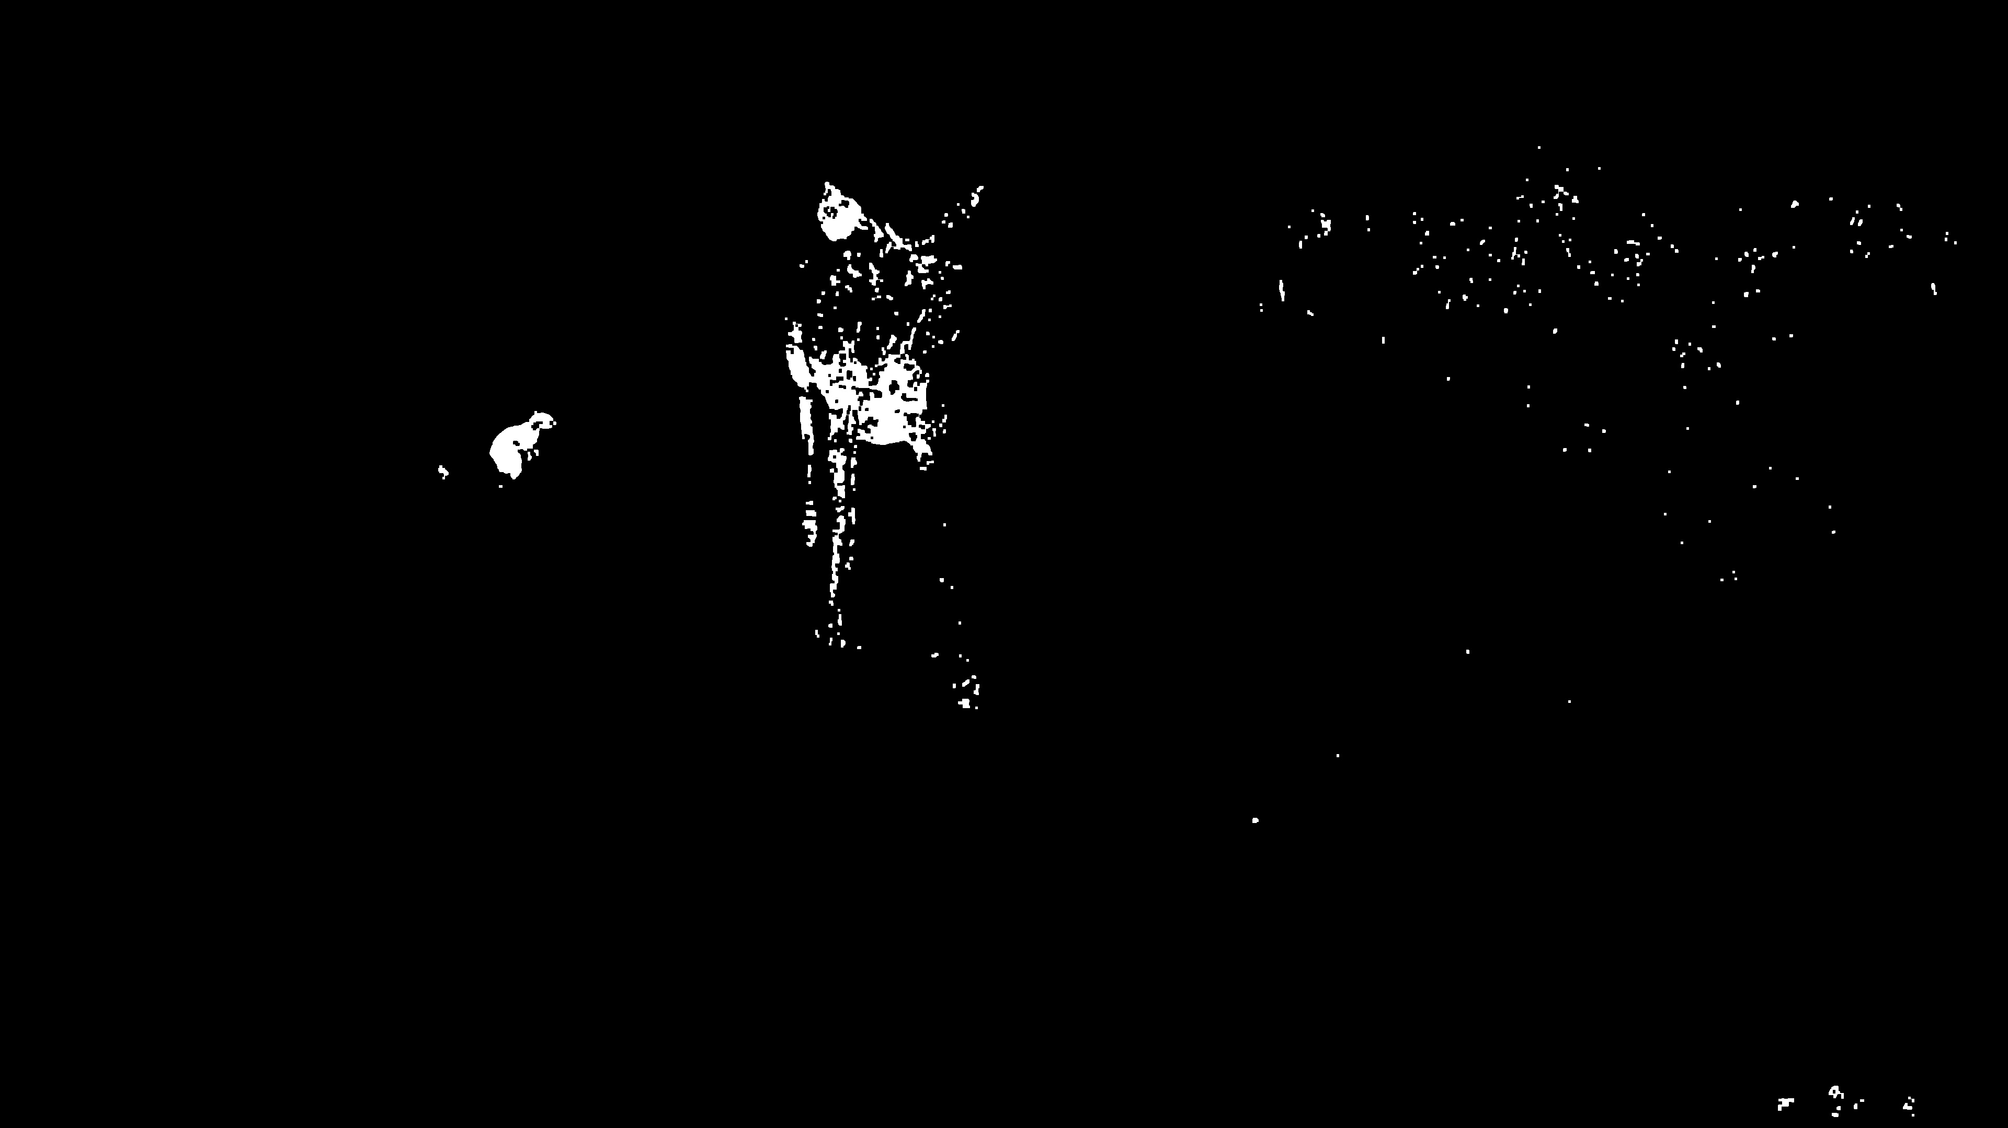

Slide 48


Results with proposed MRF

Slide 49

Results with YOLOv8

Slide 50

Results

Slide 51

Results

Slide 52

Results

Slide 53

Results

Slide 54

Results

Slide 55


Accuracy analysis
PR-Curve
R-Curve

Slide 56


Accuracy Analysis
Confusion Matrix

Slide 57
Conclusion
YOLOv8 is best fit for object detection over MRF
MRF is more focused on segmentation, and color matching
Filters with pixel change lead to best output

Slide 58
Future Work
Improve performance of YOLOv8 with Given Dataset
Enhanced Morphological filters
Training Data: YOLO's performance depends on the quality and diversity of the training dataset

Slide 59
References
[1] J. L. Marroquin, E. Arce and S. Botello, "Markov random measure fields for image analysis," Proceedings. International Conference on Image Processing, Rochester, NY, USA, 2002, pp. I-I, doi: 10.1109/ICIP.2002.1038137.
[2] C. Benedek, T. Sziranyi, Z. Kato and J. Zerubia, "A Multi-Layer MRF Model for Object-Motion Detection in Unregistered Airborne Image-Pairs," 2007 IEEE International Conference on Image Processing, San Antonio, TX, USA, 2007, pp. VI - 141-VI - 144, doi: 10.1109/ICIP.2007.4379541.
[3] J. Winn and J. Shotton, "The Layout Consistent Random Field for Recognizing and Segmenting Partially Occluded Objects," 2006 IEEE Computer Society Conference on Computer Vision and Pattern Recognition (CVPR'06), New York, NY, USA, 2006, pp. 37-44, doi: 10.1109/CVPR.2006.305.
[4] S. Schneider, G. W. Taylor and S. Kremer, "Deep Learning Object Detection Methods for Ecological Camera Trap Data," 2018 15th Conference on Computer and Robot Vision (CRV), Toronto, ON, Canada, 2018, pp. 321-328, doi: 10.1109/CRV.2018.00052.
[5] J. -H. Kim, N. Kim and C. S. Won, "High-Speed Drone Detection Based On Yolo-V8," ICASSP 2023 - 2023 IEEE International Conference on Acoustics, Speech and Signal Processing (ICASSP), Rhodes Island, Greece, 2023, pp. 1-2, doi: 10.1109/ICASSP49357.2023.10095516.

Slide 60
References
[6] Beery, Sara, Dan Morris, and Siyu Yang. "Efficient pipeline for camera trap image review." arXiv preprint arXiv:1907.06772 (2019).
[7] Fisher, Jason T. "Camera trapping in ecology: A new section for wildlife research." Ecology and Evolution 13.3 (2023).
[8] Fennell, Mitchell, Christopher Beirne, and A. Cole Burton. "Use of object detection in camera trap image identification: Assessing a method to rapidly and accurately classify human and animal detections for research and application in recreation ecology." Global Ecology and Conservation 35 (2022): e02104.
[9] Haucke, Timm, et al. "Overcoming the distance estimation bottleneck in estimating animal
abundance with camera traps." Ecological Informatics 68 (2022): 101536
[10] Home - Ultralytics YOLOv8 Docs
[11]OpenCV Countours: OpenCV: Contours : Getting Started
[12] R. Zhang, Y. Huang and S. Fu, "The development of Markov random field theory and applications on image segmentation algorithm," 2016 International Conference on Communication and Electronics Systems (ICCES), Coimbatore, India, 2016, pp. 1-5, doi: 10.1109/CESYS.2016.7889901.

Slide 61
References
[13] Quickstart - Ultralytics YOLOv8 Docs
[14] Y. Zhu, Z. Jia, J. Yang and N. K. Kasabov, "Change Detection in Multitemporal Monitoring Images Under Low Illumination," in IEEE Access, vol. 8, pp. 126700-126712, 2020, doi: 10.1109/ACCESS.2020.3008262.
[15] Yiru Wang, Liqin Fu, Kexin Liu, Rui Nian, Tianhong Yan and A. Lendasse, "Stable underwater image segmentation in high quality via MRF model," OCEANS 2015 - MTS/IEEE Washington, Washington, DC, USA, 2015, pp. 1-4, doi: 10.23919/OCEANS.2015.7404397.

Slide 62
THANK YOU

Slide 64
Motivation
Monitoring and research: To observe animal lifestyle, population sizes, distribution patterns, and habitat use
Wildlife Safety: Protect the animal and wildlife resources from the illegal activities such as habitat destruction, illegal fishing, and illegal trade of endangered species
Conflict Mitigation: Early detection of wildlife presence aids in mitigating conflicts with humans, such as crop damage and livestock predation, promoting harmonious coexistence between wildlife and communities.
Habitat Restoration: Identify areas degraded by human activities and implement restoration efforts to enhance habitat quality, thereby supporting the survival and wellbeing of wildlife populations
Bird Strike Prevention:

Slide 65
Slides that we can add
Upcoming challenges
Upcoming techniques we want to work on XXXX
Accuracy ration we want to achieve

Slide 66




Proposed Method
Step:1 Compute Pixel changes
Step:2 Data Term Calculation
Step 3: Smoothness Term Calculation
,𝑥𝑖 = 𝑥𝑗
β, otherwise
β = present degree of similarity between neighboring pixels
Notes:
Where the logarithm is used as the energy cost. The negative sign will assign lower cost to pixels, where the formation of pixel changes happens due to small birds. present the degree of 𝑠 (𝑥 𝑖 , 𝑥𝑗 similarity between neighboring pixel

Slide 67

Proposed MRF method
Step 4: Energy Function
Step 5: Post – processing
λ = Weighting parameter

Slide 68


Slide 69


Slide 70
Related Work
CNN-based method
YOLOv3 and YOLOv5 Improvements: YOLOv3 enhances class prediction and detection across different scales, whereas YOLOv5 simplifies and speeds up the process, boosting accuracy in animal tracking with CNN advancements.
Sparse Coding-based Spatial Pyramid Matching with SVMs: Combines SIFT and cLBP for feature extraction, streamlining image classification with a weighted, sparse codebook and fast Support Vector Machines.
Notes:
signals or images are represented as a sparse linear combination of basis functions

Slide 71
Research questions
Objective is more clear,
Identify animal is not research question, identify animla of certain size in xyz condition, which have xyz issues,,,,
Computational paper : DR. ortrize……
For confe. Look for researcher publications
Architecutre diagram MRF The nYOlO
How will you decide which image will go to MRF or other way
Computational analysis or time space complexity analysis

Slide 72
Take four and comaptre them, Take MRF
10 diff camera trap this ar eday time, this are nigh time, what is recall for small , for burly image , for day image and for night light for vlouse –up image
High ambitionus
Central idea to approach this
How you choose the parameters
Architecture diagram that MRF work on top of YOLO,,,,,,, first
Hoe msny searis of imagews do we need to come out of better predition for small animal
Moving on grass and detecting animal is alliges if one identify then easy to solve the problem
Its implementation not researach(hypothesis ), in x lighting condition this research eill do better thn that
Change detection in other side
Design your experiment around nit
Experimetn will show or disqualify____ Motre image processing related techniwued and

Slide 73
Related Work
Traditional Method
Mark and Recapture Model: this method utilized formal mark and recapture techniques to identify Panthera tigris populations in Nagarahole.
2. Radio Tracking and Satellite GPS Monitoring: It involve tracking animals through radio collars or GPS devices, providing valuable data for wildlife management decisions and studying animal behavior and movement.
3. Markov Random Field and Gibbs Distribution: This method applies the Markov Random Field model to contextualize pixel relationships in SAR images
Notes:
Synthetic Aperture Radar (SAR) images

Slide 74


Slide 75
How do we differentiate birds from similar-sized leaves in images, especially when the leaves' motion could mimic bird activity?
that overlook fine-grained details necessary for small object detection due to the depth of neural networks.

Slide 76


Slide 77


Slide 78


Slide 79


Slide 80


